Slide 1
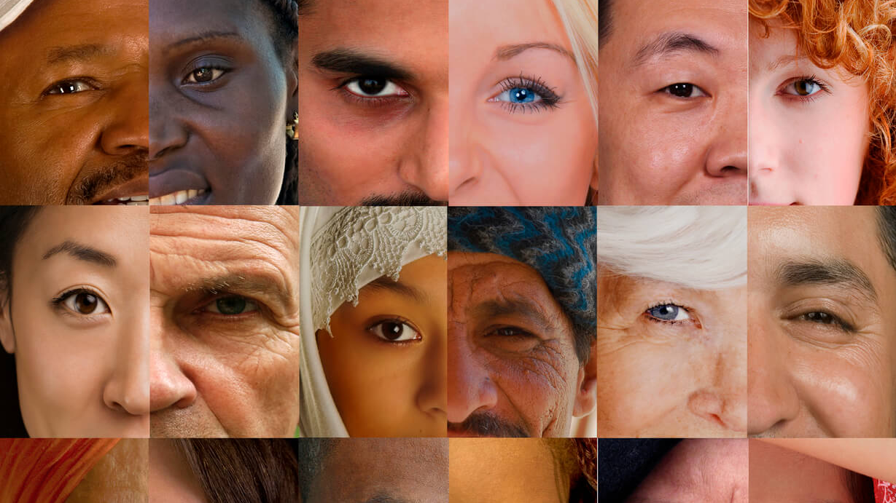

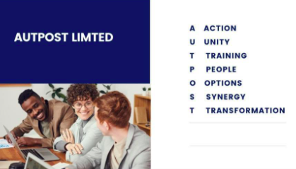


MULTICULTURALISM and vulnerability

Slide 2
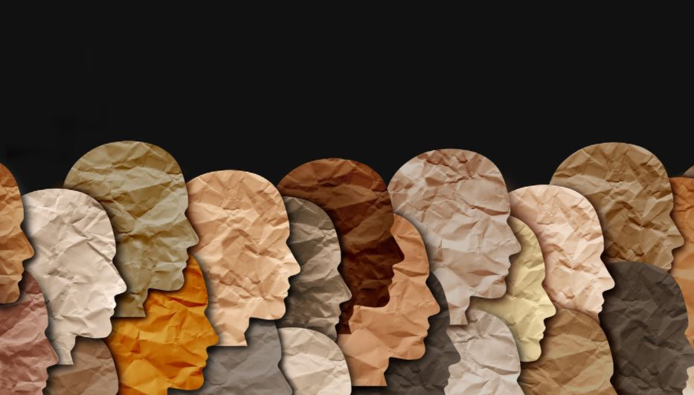
MULTICULTURALISM
The concept of multiculturalism holds that many identities and cultural groups should be respected, promoted, and acknowledged in society.
Thus, multiculturalism aims to address the problems caused by marginalisation of minorities and cultural variety.
Diversity within unity is multiculturalism's central tenet. Since the end of World War II, there has been an increase in international migration, which has encouraged the formation of multiculturalism and corresponded with the end of colonialism.
As economic migration became more common and many countries were no longer monocultural, the fall of communism also marked a historical turning point in diversity.

Slide 3
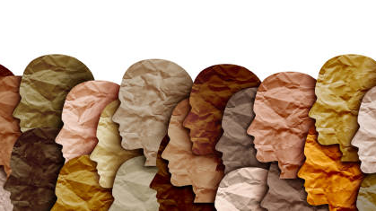
MULTICULTURALISM
Multiculturalism may take the shape of a demand for specific legal protection for certain cultural groups, recognition of contributions to the cultural life of the political community as a whole, or the assertion of autonomous powers of governance for particular cultures.
Multiculturalism serves as both a reaction to the fact that there are many different cultures in contemporary democracies and a remedy for historical marginalisation, prejudice, and persecution of some cultural groups.
Members of most contemporary democracies represent a variety of cultural perspectives, behaviours, and contributions. In the past, many minority cultural groups have been excluded or had their contributions and identities diminished.
While upholding tolerance for their differences and refraining from calling for their assimilation into the dominant culture, multiculturalism aims to include the opinions and contributions of other elements of society.

Slide 4
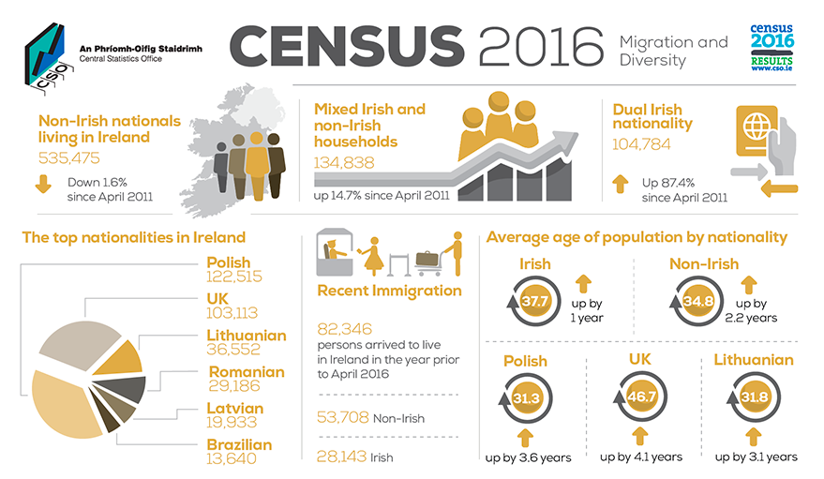
Source: https://www.cso.ie/en/releasesandpublications/ep/p-cp7md/p7md/p7anii/

Slide 5
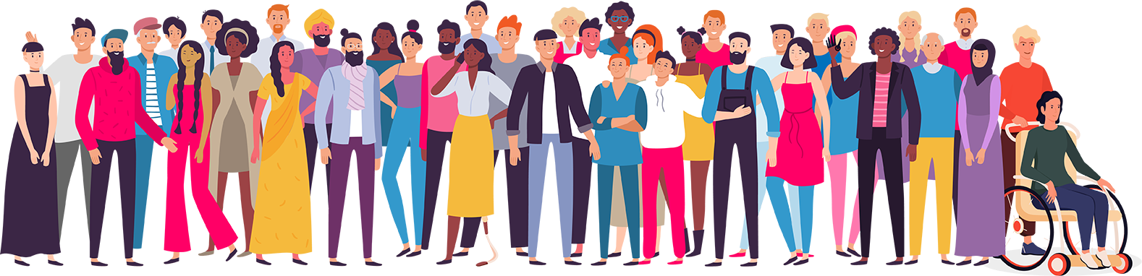
IDENTITY
One's culture influences their personal, political, and social identities among other aspects of their identity. In the sense that multiculturalism recognises and embraces the notion that culture is fundamental to one's social and political identity, it shares some of the same ideas as nationalism.
Multiculturalism is shaped by identity politics, which aims to stop the marginalisation of communities by redefining their identities away from harmful cultural stereotypes. This is accomplished through redefining the collective identity to instil a sense of pride in the group.
A prime illustration of this reframing was the emphasis on minority groups thought to be oppressed or disadvantageous throughout the 1960s and 1970s. We experienced the Gay Rights movement, Black Power, and second-wave feminism throughout these decades.

Slide 6
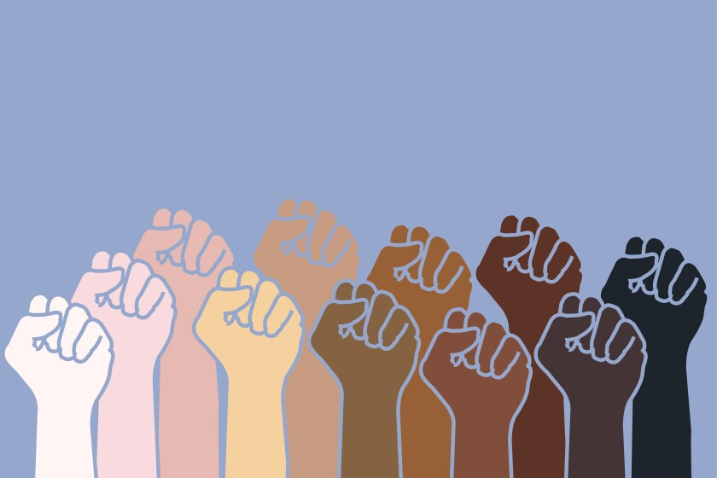
rACE
"A category of people that shares some distinguishing physical qualities”
A race is a categorisation of people into groups that are typically considered as unique within a particular culture based on common physical or social characteristics.
The phrase first became widely used in the 16th century to describe to a variety of social groupings, including those that were distinguished by tight familial ties.

Slide 7
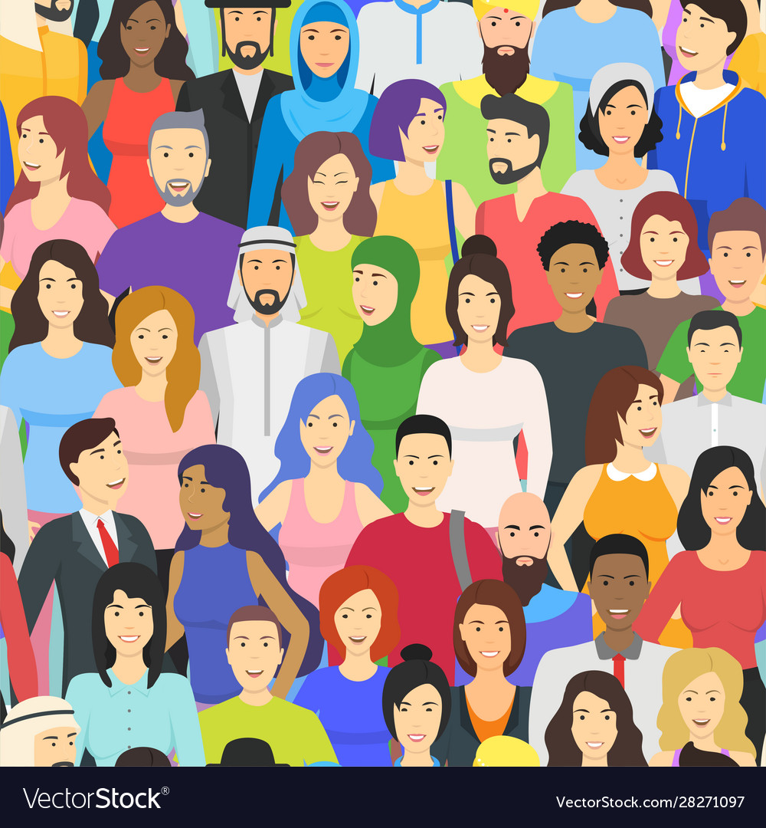
ethnicity
​The Oxford Dictionary defines Ethnicity as:
‘’the fact of belonging to a particular ethnic group (= a group of people that share a cultural tradition)’’
Although the two are legally distinct, ethnicity is occasionally used interchangeably with nationality. People who share an ethnic identity may belong to separate ethnic groups even if they share the same country, and vice versa.
Nationality is simply a person's national identity because it denotes the location of their birth. However, a person's ethnicity reveals their cultural and ancestral identity.
The hereditary position a person has in the society in which they live might be thought of as their ethnicity. It is the condition of sharing common physical or social characteristics with a segment of the population. In other words, ethnicity is a person's ethnic identity as determined by traits that are based on descent.
Genetically acquired qualities and cultural or historical inheritance are examples of descent-based traits, which refer to features that are tied to descent.

Slide 8
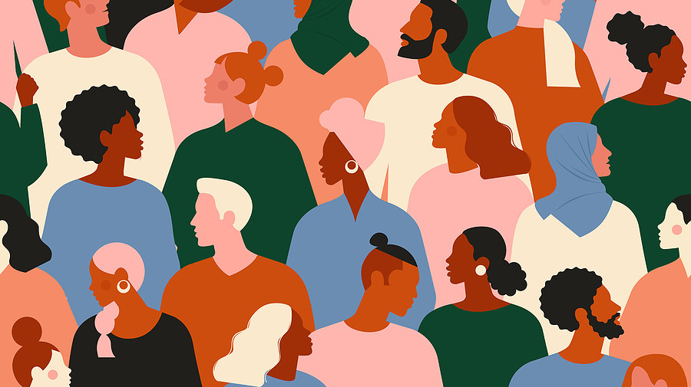
what is the difference between race and ethnicity ?
Large groupings of people classified according to a shared racial, national, tribal, religious, linguistic, or cultural origin or background are referred to as ethnicities.
"Race" is typically connected to biology and to physical traits like skin tone or hair texture.
A person's "ethnicity" is related to their cultural expression and sense of self.
Both, however, are social constructions that are used to classify and describe groups that appear to be quite different. Although race and ethnicity are sometimes confused, the social and biological sciences see them as separate categories.
Although many ethnic groups have been assimilated into racial categories at various points in history, people often acquire or reject ethnic connections more readily than racial ones.

Slide 9
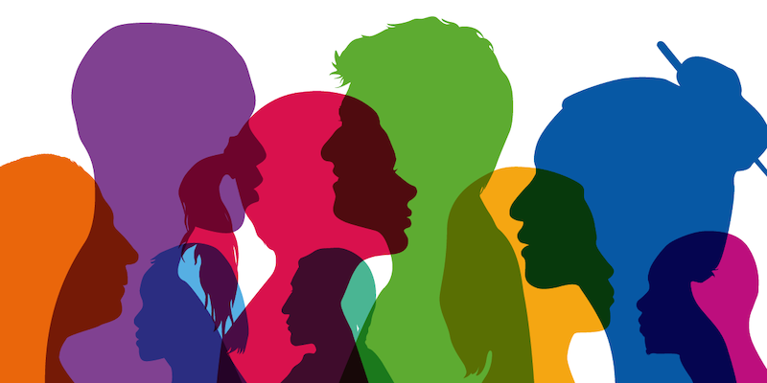
ETHNIC MINORITY
The Oxford Dictionary defines Ethnic Minority as
‘’a group of people that share a cultural tradition, religion, etc.), living in a country where the main ethnic group is different’’
The protection of a variety of minorities' rights and freedoms, including those who identify as religious, racial, ethnic, or sexual minorities, is essential to multiculturalism.
The presence of minority cultures in society must be acknowledged for diversity to exist. Minority needs must be identified, recognised, and satisfied. Minority rights, which safeguard the collective rights of minority groups including the legal protection of religious festivals and dress requirements, are one way that this has happened.

Slide 10
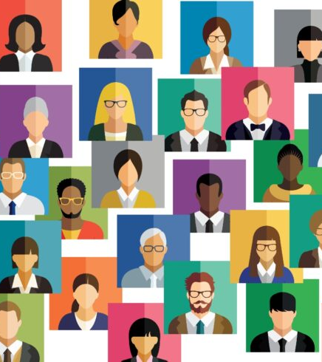
DIVERSITY
Cultural diversity is something that should be appreciated, according to multiculturalism, not merely tolerated.
Cultural diversity is advantageous and consistent with political coherence, civic cohesion, and citizenship.
Diversity is the antidote to prejudice because it fosters cultural interchange and appreciation for diversity amongst groups. Extremism and hostility are produced when a space for cultural diversity to develop is denied.
Contrary to monoculture, the global monoculture, or a homogeneity of cultures, which is comparable to cultural development, cultural variety is the quality of various or different cultures
Different cultures respecting one another's peculiarities is another definition of "cultural diversity." It is frequently used to discuss the diversity of human societies or cultures in a particular area or around the world. It alludes to the incorporation of many cultural viewpoints within a group or civilization.

Slide 11
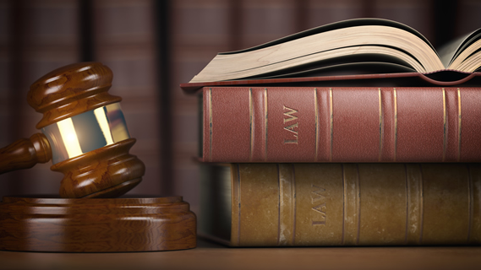
The Equal Status Acts 2000-2018 IRELAND
The Equal Status Acts 2000-2018 (‘the Acts’) ban discrimination in housing, education, and the supply of goods and services. The nine categories of gender, marriage status, family status, age, disability, sexual orientation, race, religion, and traveller community participation are all covered.
The Acts forbid discrimination against anyone who receive rent supplements, housing aid, or social welfare payments when providing accommodations services.
Subject to certain exceptions, the Acts forbid discrimination in the use of and access to goods and services, including indirect discrimination, discrimination by association, sexual harassment, and other forms of victimisation. The Acts permit constructive action to advance equality for underprivileged people or to meet the unique needs of individuals.
Advertising that is discriminatory is also forbidden. An advertising that implies an intention to discriminate, harass, or sexually harass someone or that may reasonably be construed as suggesting such an intention may not be published or exhibited.

Slide 12
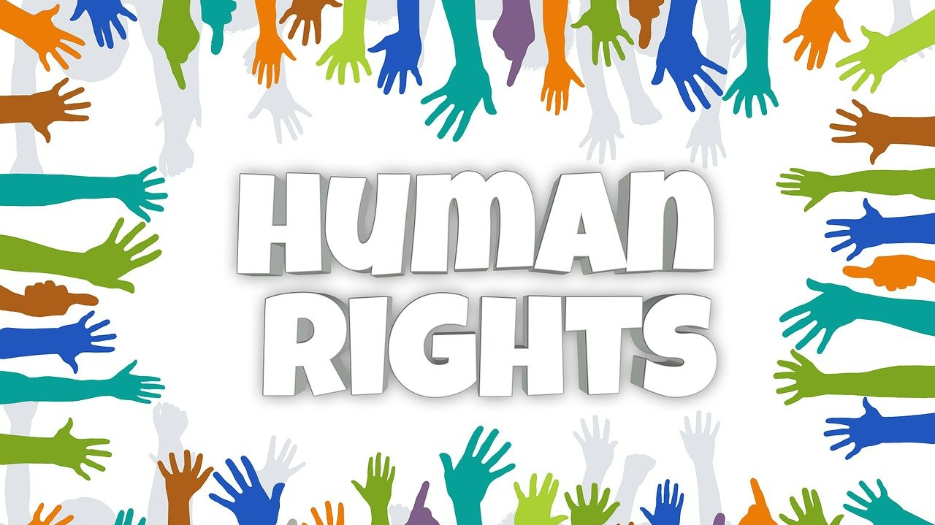
Under Irish law, the protected grounds are:
Gender (male, female, transgender or nonbinary)
If someone treats you less favourably because you are a different gender to someone else.
Civil status (single, married, separated, divorced, widowed or in a civil partnership)
If someone treats you less favourably because you have a different civil status to someone else.
Family status (a pregnant person, a parent, an acting parent of a child, or a carer of a person with a disability who requires continued care)
If someone treats you less favourably because you have a different family status to someone else.
(Note: some situations falling under this ground may also fall under the gender ground.)
Sexual orientation (heterosexual, homosexual or bisexual orientation)
If someone treats you less favourably because you have a different sexual orientation to someone else.

Slide 13
Age (only applies to those who are aged eighteen years and over)
If someone treats you less favourably because you are older or younger than someone else and it is without a good reason (‘objective justification’).
(Note: this ground does not cover alleged discrimination against children in schools.)
Religious belief (including religious background and those who have no belief)
If someone treats you less favourably because you have a different religion to someone else, or, for example, because you do not have a religion and someone else does.
Membership of the Traveller community
If someone treats you less favourably because you are a member of the Traveller community and someone else is not.
Race (skin colour, nationality, ethnic or national origin)
If someone treats you less favourably because you have a different skin colour, nationality or ethnicity to someone else.
Disability (intellectual, mental and/or physical disability)
If someone treats you less favourably because you have a disability and someone else has a different disability or does not have a disability.

Slide 14
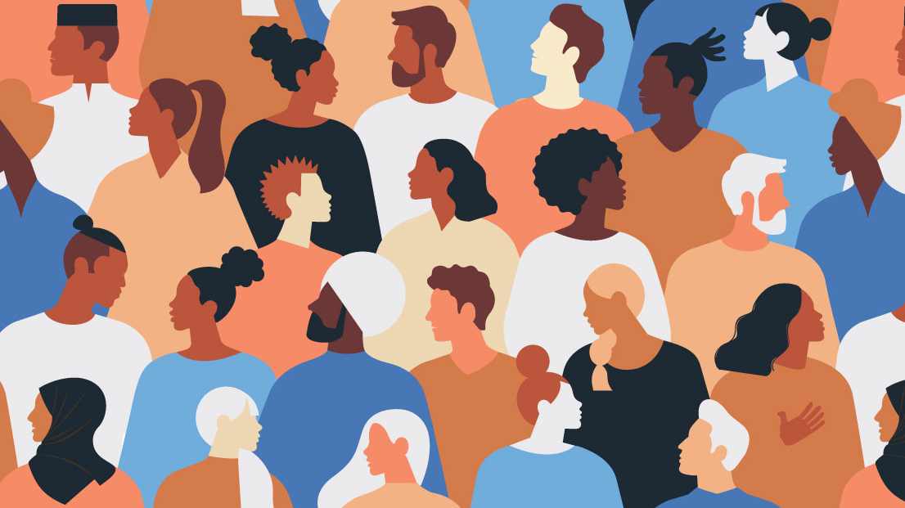
TYPES OF DISCRIMINATION
Direct discrimination
Where someone treats you less favourably than another person in a similar situation because of a different personal characteristic or circumstance that falls under the protected grounds.
Indirect discrimination
Where a seemingly neutral system or policy disadvantages you because of a personal characteristic or circumstance that falls under the protected grounds.
Discrimination by imputation
Where someone treats you less favourably than another person in a similar situation because someone has incorrectly assumed (‘imputed’) that you fall under the protected grounds.
Discrimination by association
Where someone treats you less favourably than another person in a similar situation because of your connection, relationship or association with someone who falls under the protected grounds.

Slide 15

Irish Human Rights and Equality
Commission
The Irish Human Rights and Equality Commission is Ireland’s national human rights and equality institution.
They are an independent public body that accounts to the Oireachtas, with a mandate established under the Irish Human Rights and Equality Commission Act 2014 (IHREC Act 2014). The IHREC Act includes and further enhances the functions of the former Irish Human Rights Commission and the former Equality Authority.
The purpose of the commission is to protect and promote human rights and equality in Ireland and build a culture of respect for human rights, equality and intercultural understanding in the country.
Their work is determined independently by the fifteen members of the Commission who were appointed by the Head of State, President Michael D. Higgins, in 2014. The diverse membership of the Commission broadly reflects the nature of Irish society.

Slide 16
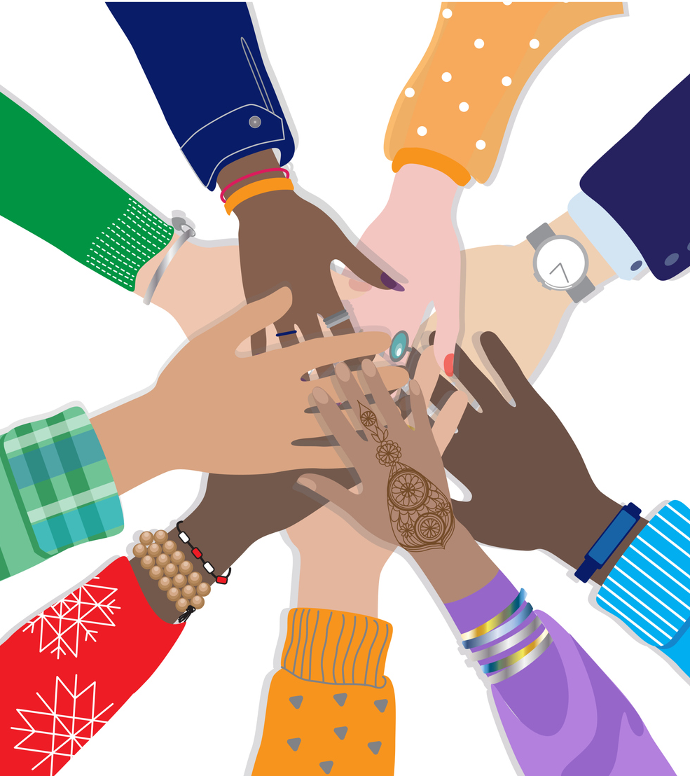
THE Equality Act 2010
The Equality Act 2010 legally protects people from discrimination in the workplace and in wider society. It replaced previous anti-discrimination laws with a single Act, making the law easier to understand and strengthening protection in some situations. It sets out the different ways in which it’s unlawful to treat someone.
It brings together over 116 separate pieces of legislation into one single Act.
The Act provides a legal framework to protect the rights of individuals and advance equality of opportunity for all.
The characteristics that are protected by the Equality Act 2010 are:
age
disability
gender reassignment
marriage or civil partnership
pregnancy and maternity
race
religion or belief
sex

Slide 17
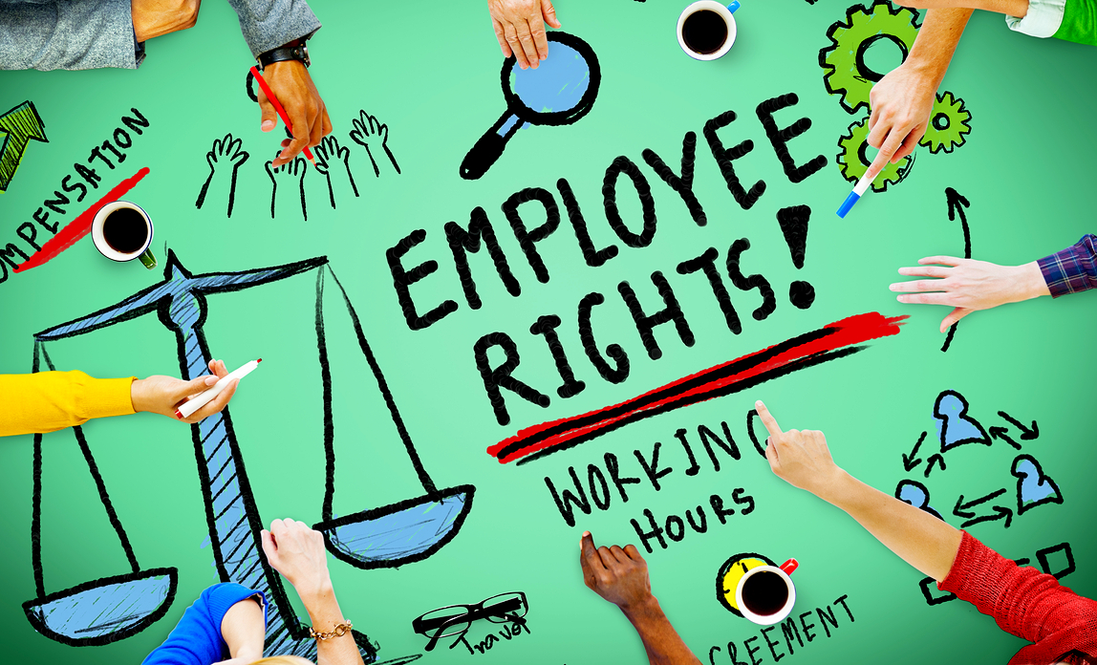
EMPLOYEMENT law IN Poland
A non-exhaustive list of grounds for discrimination has been set out in the provisions of the labour law. This means that only certain grounds for discrimination are specified as examples in those provisions.
They include: sex, age, disability, race, religion, nationality, political beliefs, union membership, ethnicity, faith, sexual orientation, fixed-term employment or employment for on a full-time or part-time basis.
Should this list lack the grounds for discrimination on which we want to rely, this does not mean that they may not be invoked before a court. Less favourable treatment of an employee on the basis of any other criterion not mentioned here, which is socially relevant, may also be regarded as discrimination.
It should be pointed out, however, that the principle of equal treatment of employees does not preclude differentiation in rights and obligations of employees on account of differences arising from their personal characteristics and differences in the performance of their work. The aforementioned principle may only be infringed upon if the diversification of the situation of employees results from application of an unlawful criterion by the employer.
There is no law that solely protects people against discrimination and protects their characteristics outside of employment in Poland.

Slide 18
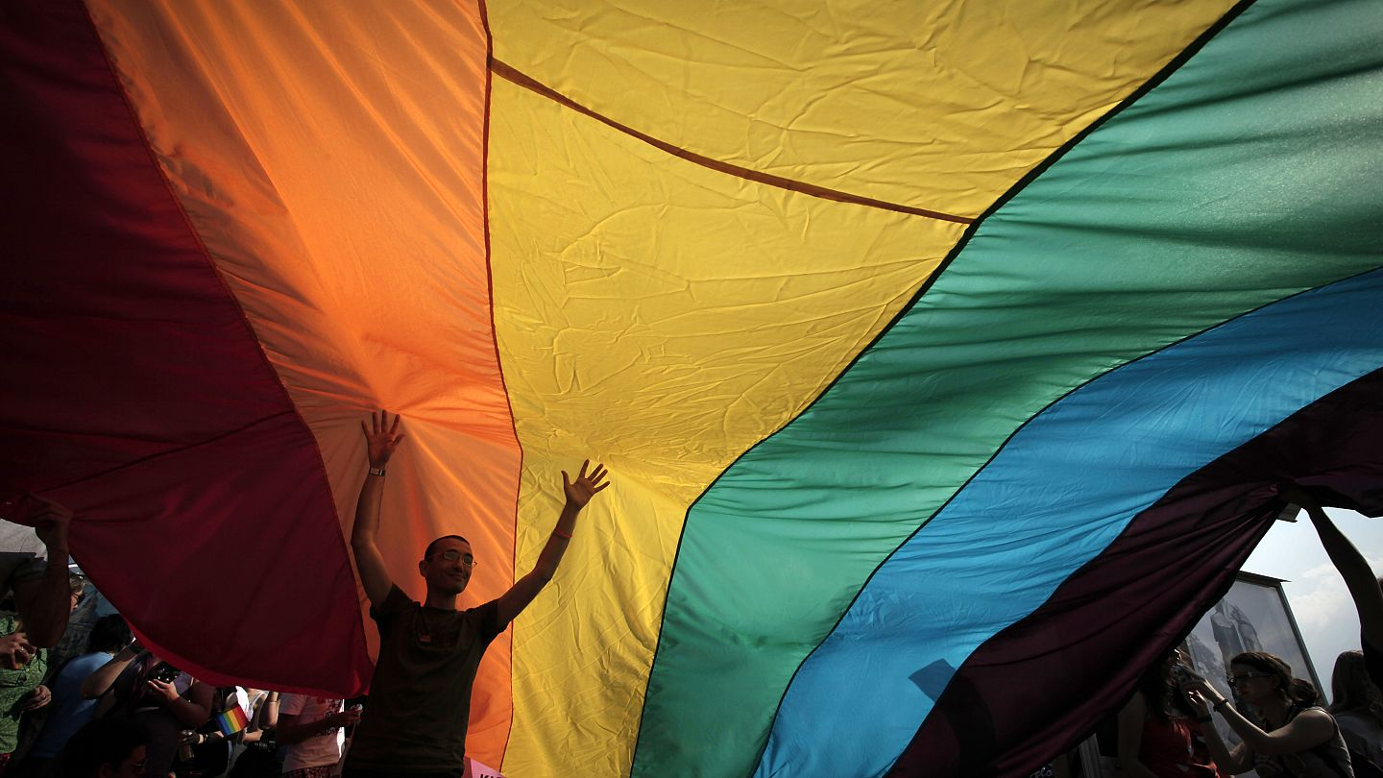
iLGA REPORT RANKS POLAND 42/49 NATIONS IN TERMS OF HUMAN RIGHTS VIOLATIONS of lgbti people
ILGA-Europe are an independent, international non-governmental umbrella organisation uniting over 700 organisations from 54 countries across Europe and Central Asia .
The authors of the ILGA Europe study rank Poland 42 out of the 49 nations they discuss, giving it a score of 15.84% on a scale where 0% represents a flagrant violation of human rights and 100% represents complete equality and respect for such rights. Poland is ranked in the following categories:
equality and non-discrimination – position 37 out of 46 – 16.24%,
family – position 43 out of 43 – 0.00%,
hate crimes and hate speech – position 38 out of 38 – 0.00%,
legal gender recognition and bodily integrity – position 27 out of 42 – 27.25%,
civil society space – position 43 out of 49 – 49.88%,
the right to asylum - position 13 out of 35 - 33.43%
Source: http://www.ilga-europe.org/report/

Slide 19
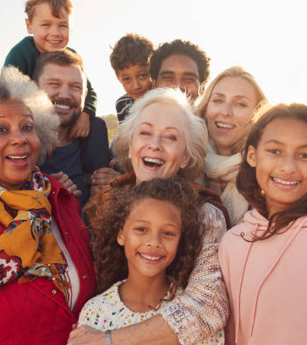
MULTICULTURAL FAMILIES
A multi-ethnic family is more than just someone with a different passport. People in a multicultural relationship may have diverse customs, faiths, language preferences, ethnicities, and other cultural characteristics that affect how they identify themselves.
An interracial family is one that includes members of various racial or cultural groups.
Third-culture children are those who were reared in a society distinct from that of their parents. These individuals are frequently multi-ethnic.
The term "intercultural family" refers to a couple with diverse cultural backgrounds. Parents can have grown up in different cultures or travelled around as much as children.

Slide 20
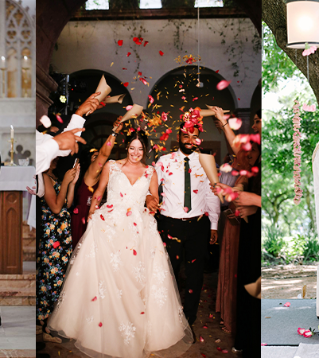
INTERETHNIC PARTNERSHIPS
In the UK and Ireland, one in ten couples—or 2.3 million people—were involved in interethnic partnerships, according to the Office for National Statistics' (ONS) most recent census.
Interfaith connections are on the rise, which is unquestionably a sign of good integration and a reflection of our more tolerant and open approach to religion, but it is not always without challenges.
It may be difficult to overcome long-standing cultural customs, and for interfaith couples considering marriage, telling family members they are engaged can be especially difficult: "My paternal grandmother didn't talk to me for a year after we were engaged.

Slide 21
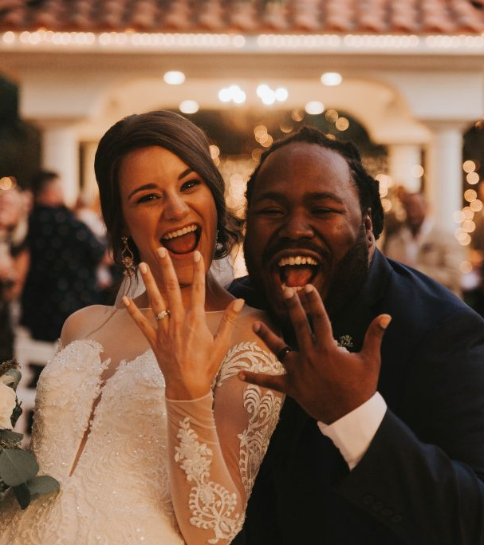
Interethnic PARTNERSHIPS
Over 4,000 Poles wed foreigners in 2014, according to data from the Central Statistical Office (GUS) on couples wed in Poland itself.
A Polish bride and a foreign husband accounted for around 3,000 of these unions.
There were 211 Italian and 342 German grooms, with 603 British husbands overall.
Although EU citizens made up the majority of the unions between Polish women and foreigners, there were also unions with residents of further-flung nations including Mauritius, Togo, Uganda, and Gambia.
In 2014, over a thousand Polish men wed foreigners (almost three times less than Polish women). Of them, Polish males married Ukrainians (505), Russians (140), and Belarusians the most commonly (118).
According to data from the Government Population Council, there were around 45,000 marriages between Poles and foreigners in Poland between 1990 and 2000.
However, there were 74,000 such unions between 2001 and 2014.

Slide 22
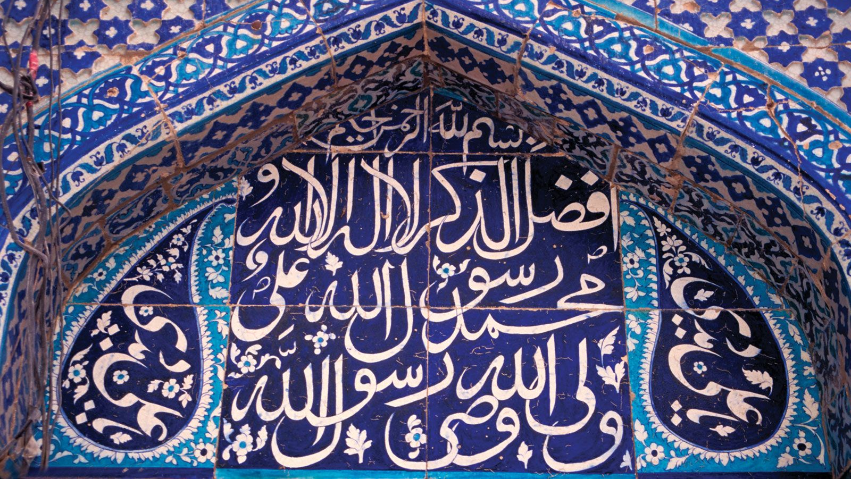
TRADITIONAL ISLAM VIEWS ON
INTERFAITH MARRIAGES
The Quran generally forbids Muslim men from marrying non-Muslim women, just as it forbids Muslim women from marrying non-Muslim men, although it does permit Muslim males to wed members of the People of the Book (often Jews, Christians, and Sabians).
Women are not given the same accommodations. Given the cultural distinctions between Muslims and non-Muslims, some Muslim academics are against all interfaith unions.
Although the Quran does not expressly forbid Muslim women from marrying non-Muslim males, some scholars contend that because the Quran permits marriages between men but not between women, Muslim women are forbidden from such unions.
According to Khaled Abou El Fadl, there was not a single classical jurist who disagreed with the ban on Muslim women marrying males who are not Muslims.
According to the Ashtiname of Muhammad, a treaty between Muslims and Christians documented between Muhammad and Saint Catherine's Monastery, the Christian spouse is not to be prevented from attending church for prayer and worship in the case of a Muslim-Christian marriage, which is to be contracted only after permission from the Christian party.
Parent attitudes remain more negative toward marriage of a daughter as compared to a son and in most cases the spouse who is not Muslim will be asked to convert.

Slide 23
TRADITIONAL ISLAM VIEWS ON
INTERFAITH MARRIAGES
Intermarriage, or consanguinity, is particularly prevalent among Muslims from south Asian and Arab backgrounds. According to recent statistics, almost 75% of Muslim marriages in Pakistan are consanguineous, and about 50% are married to first cousins.
Marriage-related sex is an acceptable, pleasurable action that is worthy of Allah's reward as a form of worship. Contrarily, having sex outside of a heterosexual marriage is viewed as sinful and should be punished in the hereafter.
According to traditional Judeo-Christian doctrine, homosexuality is viewed as wicked. But there is a difference between a homosexual desire and the actual deed. As long as the former is not used, it is fine.

Slide 24
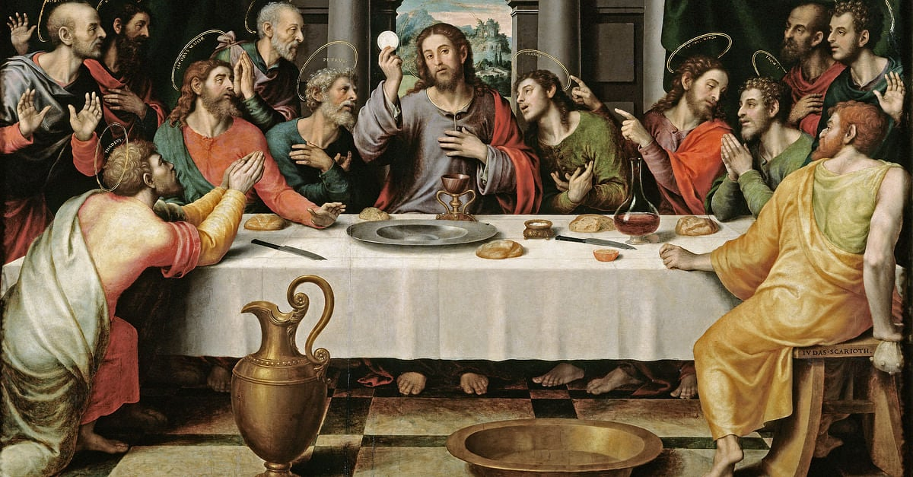
TRADITIONAL CHRISTIAN VIEWS ON INTERFAITH MARRIAGE
Christian denominations define an interfaith marriage, also known as an interreligious marriage, as a union between a Christian and a non-Christian (for example, a Christian and a Jew), as opposed to an interdenominational union, which takes the form of a Lutheran Christian marrying a Catholic Christian, as an example.
Nearly all Christian denominations allow interdenominational marriages, but with regard to interfaith marriage, many Christian denominations warn against it, citing passages from the Christian Bible that forbid it, like 2 Corinthians 6:14–15.
In 2021, religious ceremonies accounted for 57% of all marriages in Ireland. There were 6,721 (39%) Catholic marriage ceremonies, 192 (1.1%) Church of Ireland ceremonies, The Spiritualist Union of Ireland performed 1,380 (8.0%) ceremonies and 1,475 (8.6%) couples opted for other religious ceremonies.
Source: https://www.cso.ie/en/releasesandpublications/ep/p-mar/marriages2021/marriages2021mainresults/

Slide 25
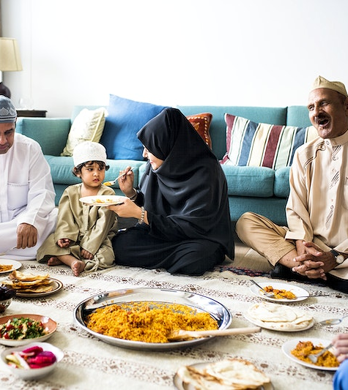
TRADITIONAL MUSILM FAMILY
The extended Muslim family often consists of three generations or more. As in most traditional civilizations, respect and regard rise with age in Muslim culture.
Due to their wealth of life experience and dominant position within the family, elderly parents are revered. It is seen of as a gift from Allah to be able to care for one's parents in their senior years.
In reality, it is typical for a newlywed to move into her husband's home. The bride's relationship with her in-laws generally undergoes a significant transformation, and issues frequently arise.
The male is seen as the family's head, but for many men, that title is a poisoned chalice since it comes with duty. Whether or whether his wife is a wage earner, the male is solely responsible for providing for the family's financial needs.
Therefore, unemployment can have a significant impact on the stability of the household, placing the male in an undefined role. In such cases, psychological morbidity may be significant and have effects on the entire family.

Slide 26
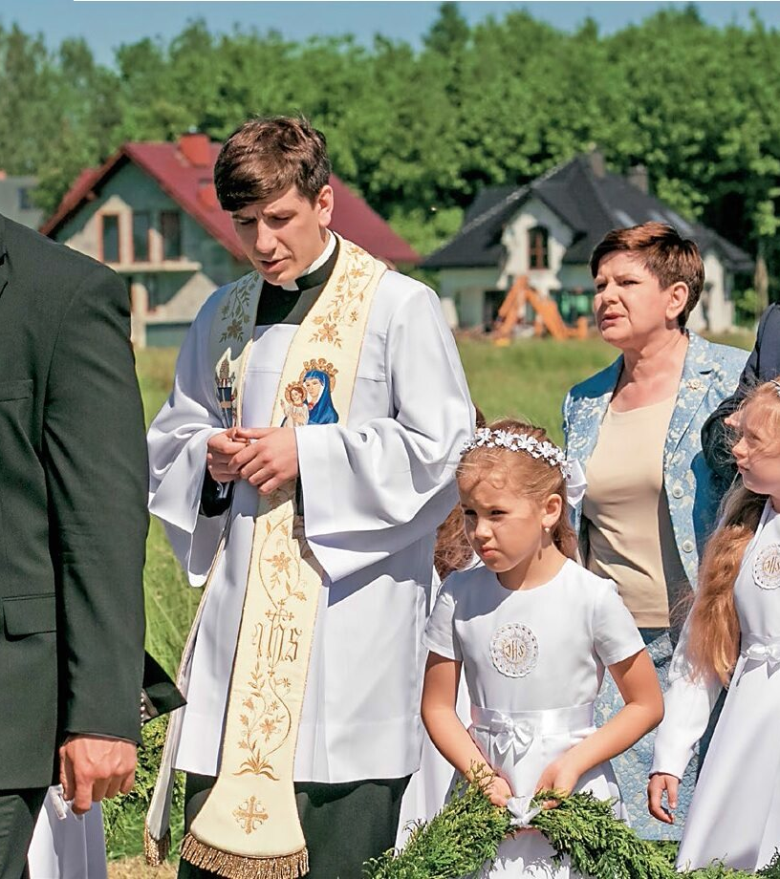
TRADITIONAL CATHOLIC FAMILY IN POLAND
Many children - in a traditional family, mothers give birth to 6-8 children on average
The dominant role of the man as the head of the family, his opinion and decisions are crucial, other family members are more or less subordinated to him
Multigenerationality, i.e. living at least three generations under the same roof
A customary division of roles - the father works and earns a living, the mother takes care of the home and raising the children, the children attend school, and when they reach the age of majority they get married
No divorces and not accepting them, marriage contracted before God is indissoluble and inviolable, divorce is treated as a grave sin
The large role of religion and ideology in the life of a traditional family, the unwavering position of the church and its teachings, priests are often presented as models of moral virtues
Developed socialization and control function - parents decide about the whole life of their children
The position of a woman is lower than that of a man, a woman is subordinate to her husband
Family problems and possible domestic violence are disregarded and hidden due to the well-being of children and the desire to prevent family breakdown

Slide 27
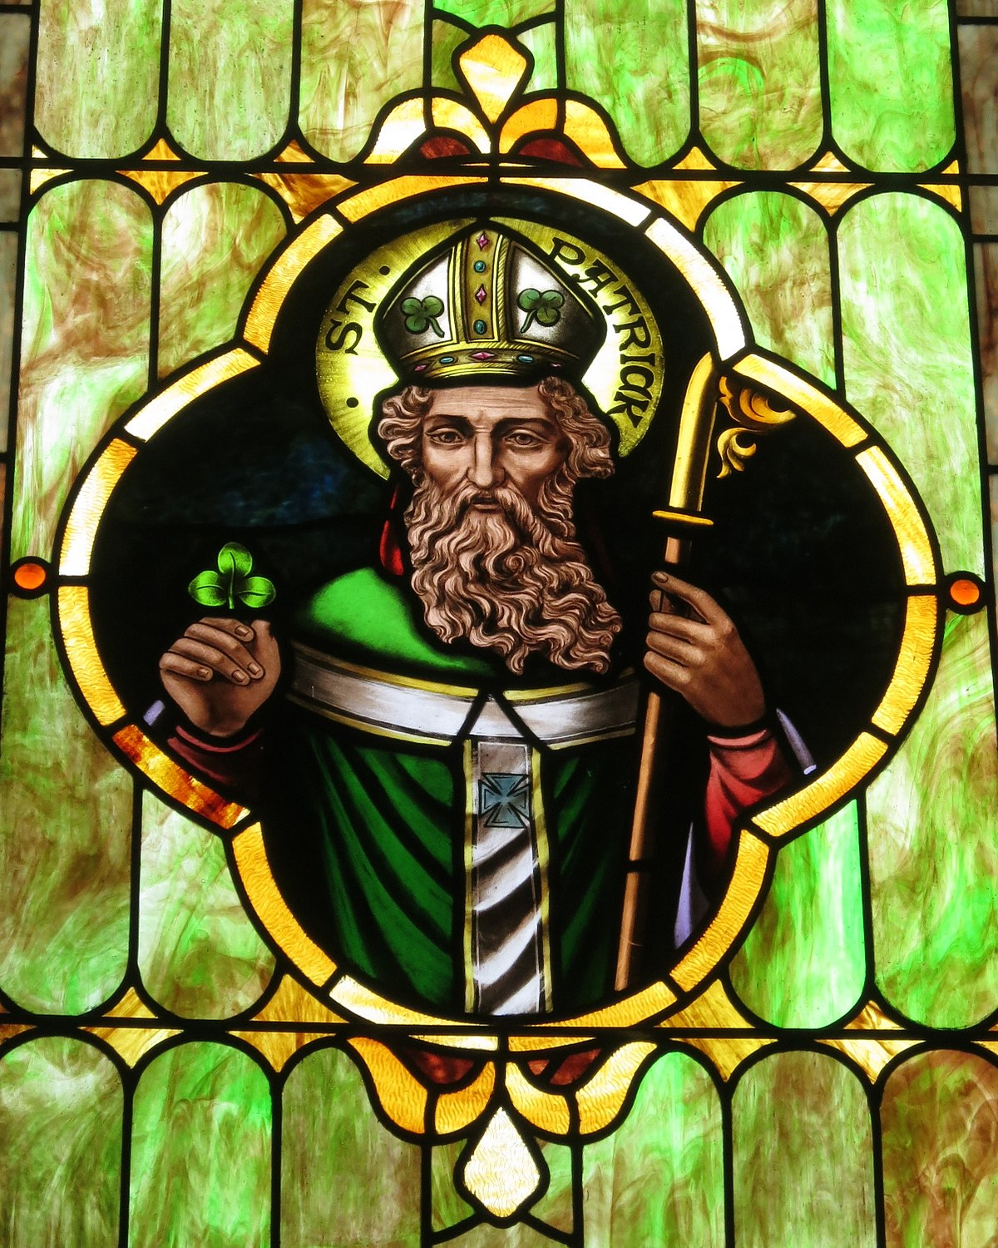
Irish roman catholics
Irish Catholics are a native Irish ethnic and religious community that identifies as both Catholic and Irish. They have a sizable diaspora, which includes more than 14 million British and over 36 million Americans.
From the 16th through the 20th centuries, conflicts between Irish Roman Catholics and Irish Protestants were particularly significant in Ireland's history, particularly during the Home Rule Crisis and the Troubles.
Although these differences are largely marked by religion, political issues and power access were at the heart of the disputes. For instance, the majority of Irish Catholics were denied political authority due of their Catholic faith despite having an identity distinct from that of Britain.

Slide 28
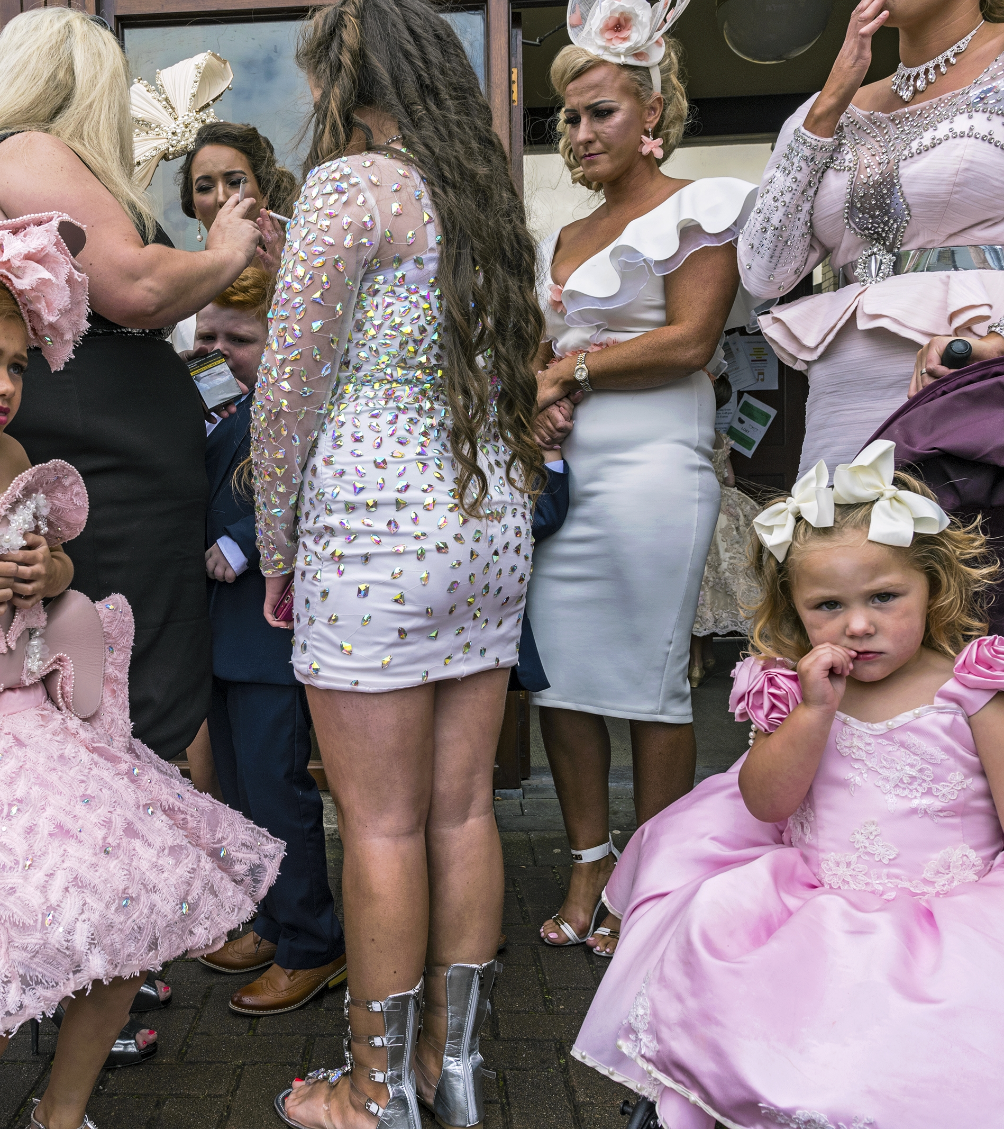
Irish travellers and gypsies
Irish Travelers are historically a nomadic people from Ireland, yet they have a unique identity, tradition, and culture from the rest of the population. Irish Travelers first appeared in Ireland in the 12th century, and they first migrated to Great Britain in the early 19th century. The Human Rights Act of 1998, the Equality Act of 2010, and the Race Relations Act of 1976, all classify the Irish Traveler community as an ethnic minority group.
Some Travelers who are of Irish descent identify as Pavee or Minceir, which are terms from the Shelta language of the Irish Travellers.
Although many of them also speak Shelta, a language with a mixed English and Irish heritage, they are mostly English speakers. Roman Catholicism, which is the most popular religion in the Republic of Ireland, is practised by the majority of Irish travellers.
Traveller representative organisations indicate that there are approximately 30,000 Travellers living in the Irish Republic. It is estimated that there are 1,500 Irish Travellers living in Northern Ireland and 15,000 in England, Scotland and Wales.

Slide 29
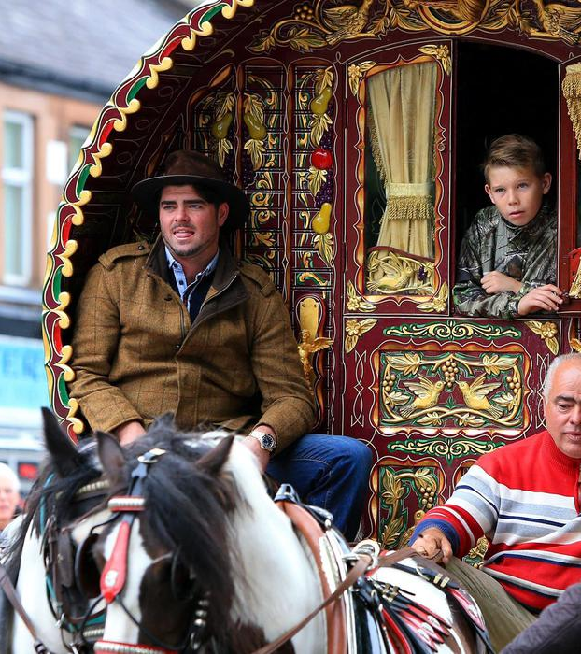
Romany gypsies
Following their emigration from continental Europe during the Roma exodus from India, Romany Gypsies have lived in Britain since at least 1515. Because of their dark colouring, the established people thought of them as "Egyptian," thus the moniker "Gypsy.”
Linguistic research on the Romani language has shown that Romany Gypsies, like the European Roma, originated in Northern India, most likely in the 12th century. Similar in origin and culture to Romany Gypsies are French Manush Gypsies.
There are different types of travellers who may pass through Ireland and Britain, including Scottish, Welsh, and English travellers. Many of these individuals may trace their ancestry back to nomadic life and may have married into or outside of more conventional Irish and Romany gipsy families.

Slide 30
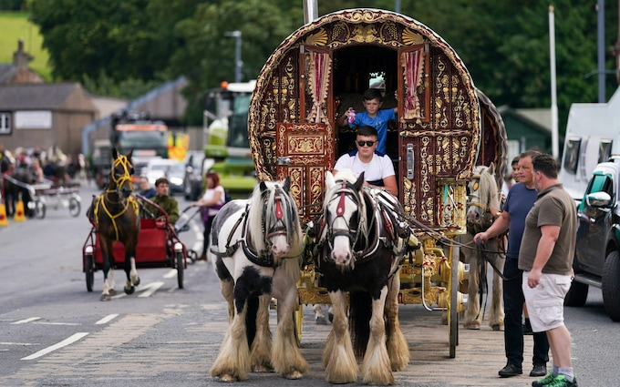
Gypsies and travellers across europe
Although the majority of Gypsies and Travelers consider travelling to be a part of who they are, they can choose to live in a variety of ways, such as:
Moving frequently from site to site and living "on the road" permanently in caravans or mobile homes, on council-provided sites or on private sites, residing in settled housing during the winter or during the school year and travelling during the summer while preserving a strong commitment to Gypsy/Traveller culture and traditions.
The Roma communities also originated from India from around the 10th/ 12th centuries and have historically faced persecution, including slavery and genocide.
They are still marginalised and ghettoised in many Eastern European countries (Greece, Bulgaria, Romania etc) where they are often the largest and most visible ethnic minority group, sometimes making up 10% of the total population. However, ‘Roma’ is a political term and a self-identification of many Roma activists. In reality, European Roma populations are made up of various subgroups, some with their own form of Romani, who often identify as that group rather than by the all-encompassing Roma identity.
Travellers and Roma each have very different customs, religion, language and heritage. For instance, Gypsies are said to have originated in India and the Romani language (also spoken by Roma) is considered to consist of at least seven varieties, each a language in their own right.

Slide 31
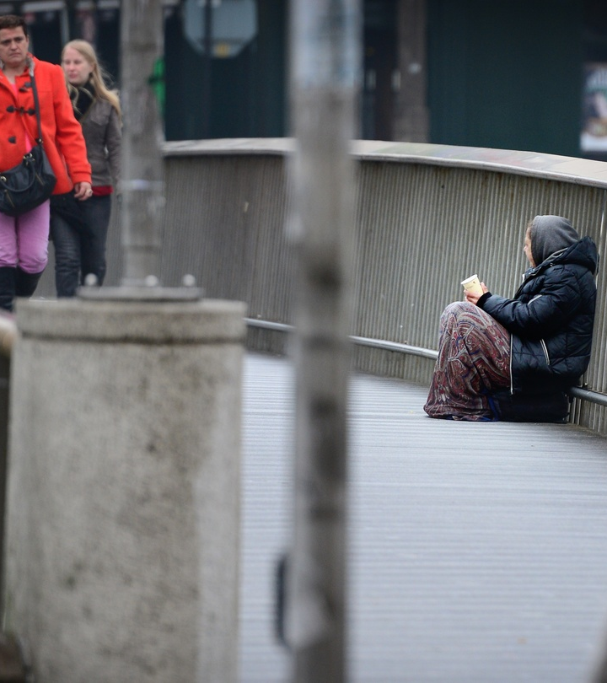
Vulnerability
Vulnerability
Being vulnerable is defined as in need of special care, support, or protection because of age, disability, risk of abuse or neglect.
Childhood vulnerability
There is no commonly used definition of childhood vulnerability. A child can be vulnerable to risks and poor outcomes due to individual characteristics, the impact of action or inaction by other people and their physical and social environment.
Vulnerable adults
Any adult (person over the age of 18) unable to take care of themselves or protect themselves from exploitation.
Many factors can influence adult vulnerability, experiences of vulnerability in childhood may negatively impact adults in later life – particularly if someone has fewer protective factors in place, such as a supportive family or a stable household income.

Slide 32
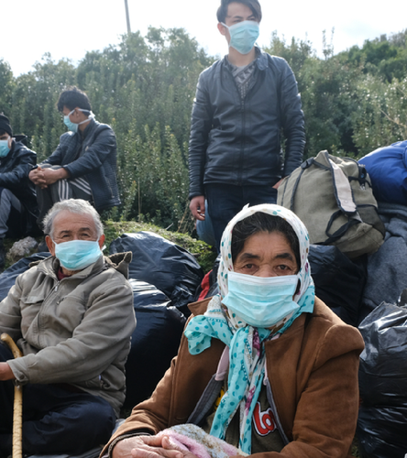
Vulnerable persons
Adults have the right to safety and an abuse-free existence. This right belongs to everyone, no matter what their circumstances. All service providers, both statutory and non-statutory, have a duty to ensure that clients are treated with respect and dignity, that their welfare is promoted, and that they receive assistance in a setting where every effort is made to advance welfare and prevent abuse, according to the national policy and procedures known as Safeguarding Vulnerable Persons at Risk of Abuse.
A number of principles are outlined to advance the welfare of vulnerable persons and protect them from abuse in the "Safeguarding Vulnerable Persons at Risk of Abuse - National Policy and Procedures," which is applicable to all HSE and HSE funded services.

Slide 33
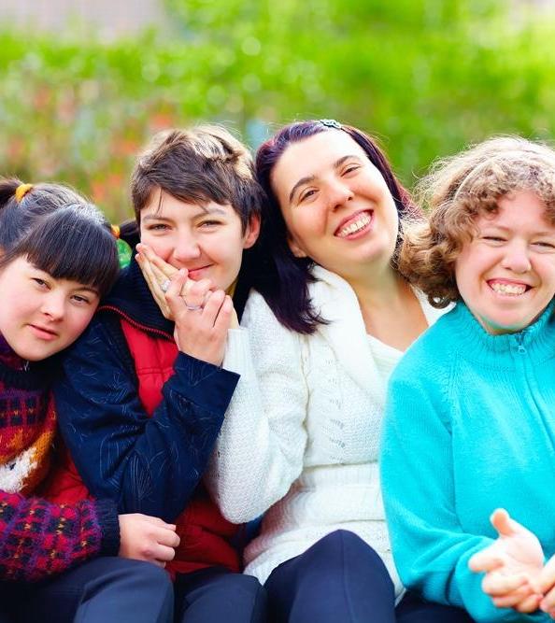
Vulnerable adults
It is a legal requirement that all services have a publicly stated "No Tolerance" policy for any kind of abuse and must encourage a culture.
A national strategy for advancing adult welfare was developed by Safeguarding Ireland in order to protect adults who may be vulnerable from all types of abuse by people, groups, and institutions.
This was accomplished through encouraging cross-sectoral cooperation, increasing public and professional awareness and education, and conducting research to guide Republic of Ireland policy, practise, and law. Safeguarding Ireland released its first Strategic Plan in December 2017, covering a five-year period to the end of 2021.

Slide 34
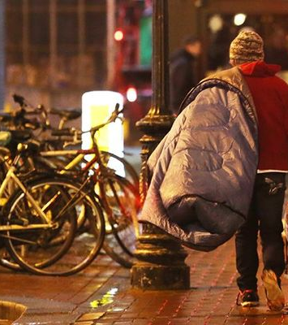
Who is the most at risk?
Economically disadvantaged people, members of racial and ethnic minorities, those without insurance, low-income kids, the elderly, those who are homeless, those with HIV, and people with other chronic health issues, such as severe mental illness, are among the vulnerable groups.
Residents in rural areas, who frequently face obstacles in obtaining healthcare services, may also be included.
These people's susceptibility is increased by variables including poverty, insurance coverage (or lack thereof), and the lack of a regular provider of treatment, as well as by their colour, ethnicity, age, and sexual orientation. Their health issues and medical issues are intertwined with societal issues including housing, poverty, and poor education.

Slide 35
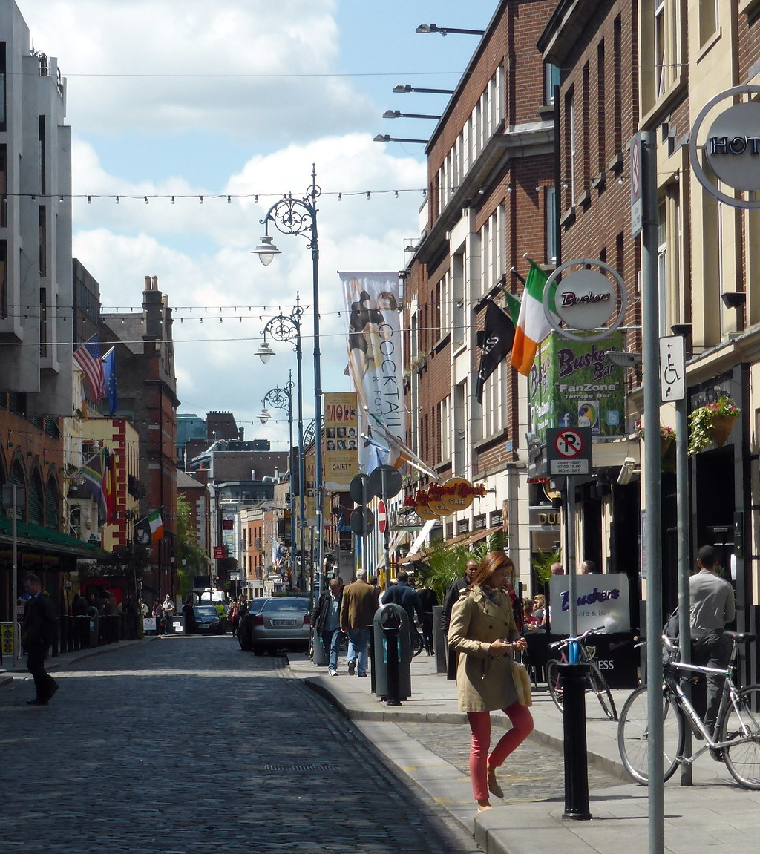
Vulnerable background
Every aspect of a child's or adults life contains risk and protective variables, which work differently depending on the stage of development.
The experiences a particular person has in their home and those they have in the larger community are intricately intertwined.
For example children who have negative experiences, both at home and in the community, may not only have lower outcomes as a result of these events, but they may also engage in dangerous behaviours when they become older, which raises their risks even more.
This may lead to ongoing inequity from one generation to the next. It emphasises how crucial it is to address the risk factors that increase vulnerability on an individual basis as well as the root causes of more general risk factors in families and communities.

Slide 36
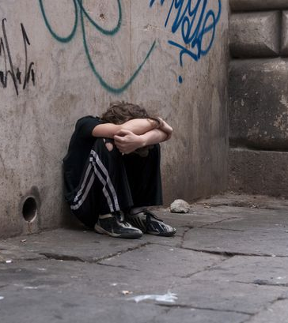
Risk factors that affect vulnerability
The social determinants of health that are present in the environments in which children and young people are born, live, study, and develop have a profound impact on their physical, emotional, and mental health. At the population level, traumatic experiences and unfavourable circumstances throughout childhood are linked to long-term effects on outcomes.
This does not necessarily imply that all children who endure stress and hardship will have worse results. The existence of protective variables, such as a loving family, will also play a significant role in determining outcomes.
Risk factors can enhance a person's vulnerability, although they may just be a contributing factor and not the actual cause of vulnerability. Not everyone who is diagnosed as being at risk becomes susceptible, and risk factors are not absolute.

Slide 37
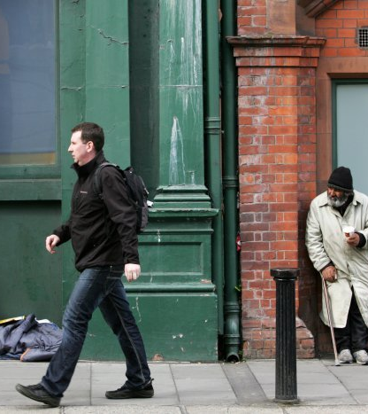
risk factors: Individual
genetic or biological
perinatal trauma
early malnutrition
behavioural and learning difficulties
alcohol and substance misuse
traumatic brain injury
gender

Slide 38
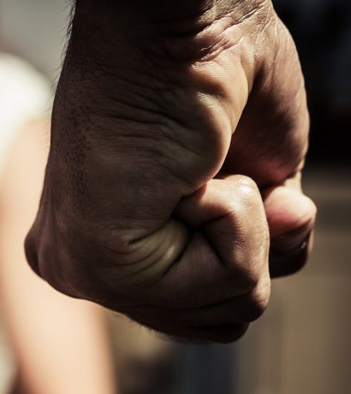
Risk factors : relationships
Risk factors in relationships include:
low family income
poor parenting and inconstant discipline
family size
abuse – emotional, physical or sexual
emotional or physical neglect
household alcohol or substance misuse
household mental health
family violence
family breakdown
household offending behaviour

Slide 39
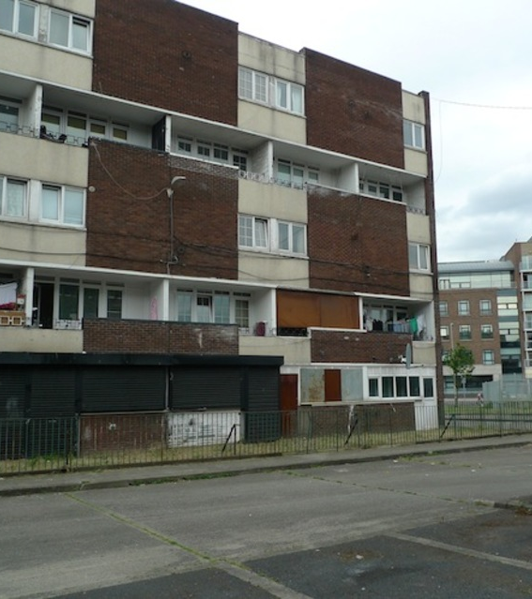
Risk factors: society
Risk factors in societies include:
socio-economically deprived communities
high unemployment
homelessness or poor housing
a culture of violence, norms and values which accept, normalise and glorify violence
discrimination
difficulties accessing services

Slide 40
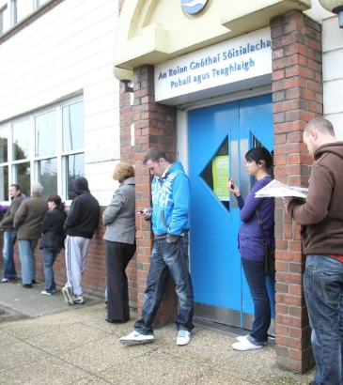
A lack of awareness about the impact of vulnerability can lead to:
social exclusion
absence of assistance or further referral
the possibility of traumatization again
Trauma experiences, often dating back to childhood, have been linked to an increased chance of a variety of unfavourable results.
Given that vulnerability is intricate and multidimensional, the following are some instances of the effects vulnerability may have on a person:
higher likelihood of having less education
bad repercussions for one's physical and mental health
Special educational needs (SEN) are 4 times more prevalent in children than in the general kid population, and adolescent parents are more likely to have SEN.
relationship between being in foster care and offending loneliness and isolation are associated with offending, living in poverty, and having developmental deficits in children.
more prone to experience communication issues
Unbalanced health needs r(mental health, alcohol use, and learning disabilities)
violence witnesses run a higher risk obesity, depression , smoking, and sexual behaviour
Poor respiratory and mental health due to housing

Slide 41
bibliography
https://www.britannica.com/topic/multiculturalism
https://www.studysmarter.co.uk/explanations/politics/political-ideology/multiculturalism/
https://www.cso.ie/en/releasesandpublications/ep/p-cp7md/p7md/p7anii/
https://www.oxfordlearnersdictionaries.com
https://keydifferences.com/difference-between-ethnicity-and-nationality.html
https://www.ihrec.ie/documents/a-guide-the-employment-equality-acts/
http://www.salfordnow.co.uk/2017/09/15/why-interfaith-marriage-is-a-labour-of-love/
http://archiwum.thenews.pl/1/10/Artykul/217477
https://en.wikipedia.org/wiki/Interfaith_marriage_in_Islam
https://travellermovement.org.uk/gypsy-roma-and-traveller-history-and-culture
https://www.ncbi.nlm.nih.gov/pmc/articles/PMC1071164/
https://en.wikipedia.org/wiki/Interfaith_marriage_in_Christianity
https://www.equalityhumanrights.com/en/equality-act-2010/what-equality-act
https://pl.wikipedia.org/wiki/Sytuacja_prawna_i_społeczna_osób_LGBT_w_Polsce
https://eszkola.pl/wos/rodzina-tradycyjna-9952.html
https://www.legislation.gov.uk/ukpga/2010/15/contents
https://www.hse.ie/eng/about/who/socialcare/safeguardingvulnerableadults/safeguardingvuladts.html
https://www.ajmc.com/view/nov06-2390ps348-s352
https://www.gov.uk/government/publications/vulnerabilities-applying-all-our-health/vulnerabilities-applying-all-our-health
https://www.hse.ie/eng/services/publications/socialinclusion/interculturalguide/traveller/traveller.pdf

