Slide 1



PRINCIPLES OF EFFECTIVE MULTICULTURAL MEDIATION

Slide 2
IMPARTIALITY
The mediator has a responsibility to behave impartially at all times and to guarantee that this impartiality is never jeopardised by a conflict of interest, whether it is current or potentially can become.
The mediators must not have any personal interest in the outcome of mediation.
Mediators are not permitted to mediate any disputes in which they have learned information that might put them in a conflict of interest professionally or privately.

Slide 3
IMPARTIALITY
The mediation process must always be conducted by mediators in a fair and unbiased manner, while maintaining their objectivity towards the participants.
Any participant's manipulative, threatening, or intimidating behaviour must be avoided by mediators. Any power disparity between the participants must be addressed as much as feasible throughout the conduct of the procedure.
The mediators must take reasonable action to try to avoid this, including ending the mediation if required, if such behaviour or any other imbalance looks likely to make the mediation unfair or ineffective.

Slide 4
VOLUNTARY PARTICIPATION
Participation in mediation is voluntary at all times and participants and the mediator are always free to withdraw.
Where mediators consider that a participant is unable or unwilling to take part in the process freely and fully, they must raise the issue and possibly suspend or terminate the mediation.

Slide 5
NEUTRALITY
At all times, mediators must maintain objectivity towards the mediation's result.
Mediators must avoid trying to force or persuade parties to adopt their chosen resolution.
If the participants agree, they may, however, let them know the resolutions.
They may provide participants with information about potential actions, their legal or other repercussions, and help them investigate these, but they must be clear that they are not providing advise.

Slide 6
CONFIDENTIALITY
Without each participant's express permission, mediators are not permitted to speak about the mediation or interact with any participant's legal representation.
The appropriate Social Services department must be informed whenever it seems necessary for a specific allegation that a child has experienced significant harm to be thoroughly investigated or whenever mediators have reason to believe that a child is currently experiencing or is likely to experience significant harm.
If mediators believe that other public policy factors, such as an adult who has suffered or is likely to suffer considerable harm, predominate, they may contact the relevant authorities.

Slide 7
WELFARE OF CHILDREN
The welfare of any family children must always be a priority for mediators. Participants should be urged to pay attention to both their own needs and interests as well as the needs and interests of the children.
Participants can be encouraged by mediators to take the children's desires and feelings into account. If it is suitable, they may talk with them about whether and how much it is okay to consult the children directly to get their thoughts and feelings.
Children's consent must first be acquired when mediators and both parties agree that it is acceptable to consult any children directly. Such mediators are required to offer suitable spaces for direct consultation.

Slide 8
WELFARE OF CHILDREN
When a mediator meets directly with a child, they are required to respect any disclosure the child may make to them by maintaining their confidentiality. Before the participants consent to the direct consultation, this needs to be conveyed to them.
If the mediator has reason to believe that any child is experiencing or at risk of experiencing severe harm, they are required to contact the appropriate authorities for assistance.
Mediators may withdraw from mediation if they believe that the participants are acting or plan to act in a way that would gravely jeopardise the welfare of any family member or child.

Slide 9
ABUSE AND POWER IMBALANCE
The possibility of participant power imbalances must be recognised by mediators.
Mediators must work to make sure that parties engage in the mediation voluntarily and without fear of injury or violence. They must conduct a screening process to ascertain whether someone is concerned about abuse and threats.
When abuse is reported or suspected, mediators must ask a participant whether they want to participate in mediation and should also notify them of the support resources that are available.
Where mediation does take place, mediators are required to preserve the values of consent, justice, and safety throughout. Also, precautions must be made to guarantee everyone's safety during arrival and departure.
Throughout the mediation, mediators must work to stop either party from engaging in manipulative, threatening, or intimidating behaviour.

Slide 10

UNITED NATIONS GUIDANCE
The Advice is based on the collective expertise of the world's nations. Its development gained input from Member States, the UN system, regional, subregional, and other international organisations, non-governmental organisations (NGOs), women's groups, religious leaders, the academic community, mediators and mediation specialists.
The fundamental principles the Guidance lists as being important to take into account in a mediation effort in order to address these issues are: preparedness, consent, impartiality, inclusivity, national ownership, international law and normative frameworks, coherence, coordination and complementarity of the mediation effort, and quality peace agreements.

Slide 11
UNITED NATIONS GUIDANCE :PREPARADNESS
Effective preparation is necessary for responsible and credible mediation activities. In order to be prepared, a mediator must combine their specialised expertise and abilities with a coherent team of professionals.
As a result of being prepared, the mediator is better able to direct and oversee the mediation process, aid in enhancing (as needed) the negotiating skills of the conflict parties and other stakeholders, help them come to agreements, and mobilise support (including from international actors) for implementation.
In order to properly manage expectations, maintain a feeling of urgency while avoiding easy fixes, and respond to opportunities and obstacles in the entire process, a mediator must be well-prepared and supported.

Slide 12
UNITED NATIONS GUIDANCE :PREPARADNESS
Choose a skilled mediator who has the necessary expertise, experience, sensitivity to cultural differences, and abilities for the particular dispute scenario.
Support the mediator with a group of experts
Conduct conflict analysis and routine internal reviews of the procedure to allow for any necessary modifications to the mediation tactics.
Provide mediators and their teams with appropriate training, orientation, and preparedness.
Multiculturalism should be understood by all team members within their various fields of competence.
A person of integrity, the mediator should be seen as authoritative, neutral, and objective.

Slide 13
UNITED NATIONS GUIDANCE: CONSENT
The parties must agree to the mediation in order for it to be successful. Parties are less inclined to engage in discussion or commit to the mediation process without consent.
To build the environment for mediation and ensure that everyone has a solid knowledge of it, multicultural mediators must cultivate consent.
Build trust between the parties to the conflict, between the mediator and the parties, and confidence in the mediation process by implementing confidence-boosting strategies at various phases.
Respect confidentiality while administering the mediation process in a consistent, open, and impartial manner.
Regularly evaluate if there is enough consent for the process, and be ready for changes in consent during the mediation.

Slide 14
UNITED NATIONS GUIDANCE :INCLUSIVITY
The degree to which the needs and opinions of disputing parties and other interested parties are acknowledged and integrated into the mediation process and its results is referred to as inclusivity.
The core causes of conflict are more likely to be found and treated through an inclusive process, and it will also guarantee that the demands of the impacted populations are met.
Moreover, inclusivity strengthens the legitimacy and sense of national ownership of the peace agreement and its execution.
A permanent peace that takes into account the demands of everyone affected by the conflict requires a certain level of inclusiveness, which mediators should determine based on a thorough mapping of all conflict parties and stakeholders.

Slide 15
UNITED NATIONS GUIDANCE:
NORMATIVE FRAMEWORKS
Make sure that the parties are aware of the requirements and restrictions imposed by any applicable regulations and international laws.
Provide access to engage directly with conflict parties with relevant rules while maintaining a balance between the need to uphold international norms and avoiding blatantly adopting an advocacy role.
Be clear and explain their mandates and the legal parameters applicable to their work; be informed on and knowledgeable with the relevant international law and normative frameworks.

Slide 16
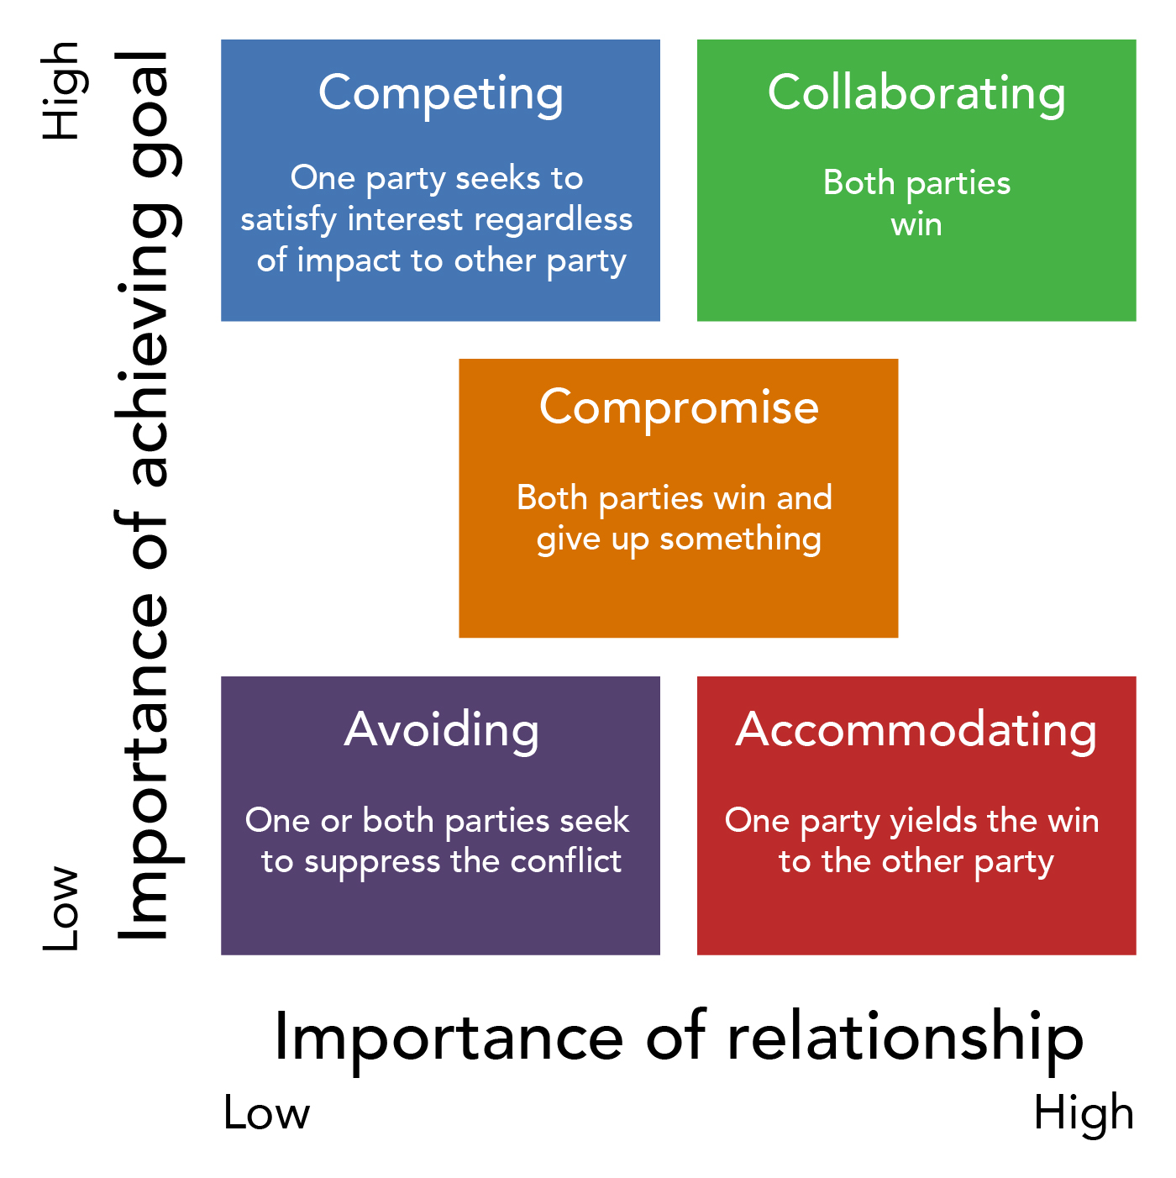
CONFLICT MANAGEMENT STYLES
The primary method for effective conflict resolution is to choose a conflict management style appropriate to the conflict.
Most people have a preferred style that we use, however, we are all competent in choosing a different style when it is appropriate.

Slide 17
THOMAS – KILLMAN
CONFLICT MODE INSTRUMENT (TKI)
The TKI identifies five different styles of conflict: Competing (assertive, uncooperative), Avoiding (unassertive, uncooperative), Accommodating (unassertive, cooperative), Collaborating (assertive, cooperative), and Compromising (intermediate assertiveness and cooperativeness).
During a multi-stage research procedure, each pair of assertions was intentionally created to have an equal level of social desirability.
Thirty pairs of statements make up the Thomas-Kilmann Conflict Mode instrument. The respondent must select either the A or B item for each pair (for example, one item depicts collaborating while the other item describes avoiding).
The TKI uses two axis called "assertiveness" and "cooperativeness.”

Slide 18

COLLABORATING
Thomas and Kilmann define collaboration as a process of addressing problems together with the intention of meeting the needs of those involved. On both the assertiveness and cooperativeness ratings, this mode scores high.
As people in intimate connections are more likely to probe further to identify the source of the dispute and potential solutions, this mode may be made more effective.
This mode is most effective when an integrative solution is required and all parties demands must be met.
Due to its intense nature and time or scale requirements, collaborative conflict management may be both emotionally and physically draining.
Prior to engaging in this conflict management style, the parties should be able to communicate their requirements and goals in order to achieve good results.
Due of its in-depth nature, this conflict style is bad for resolving smaller, more minor concerns.

Slide 19
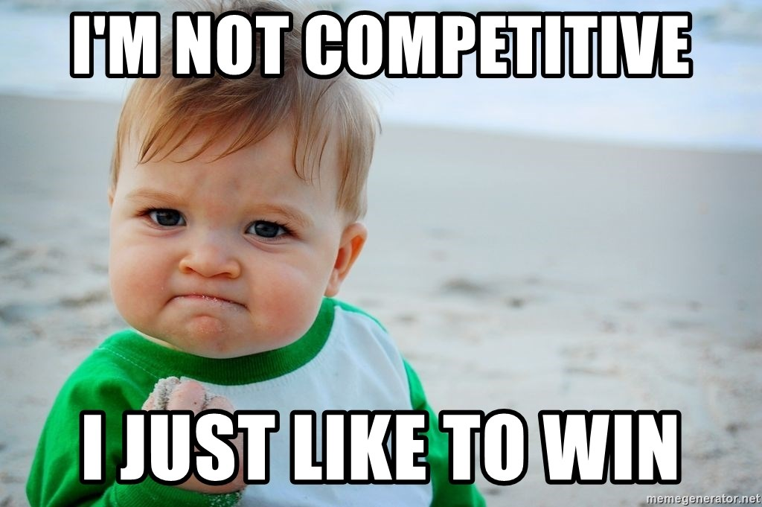
COMPETING
The competitive mode is assertive and frequently leads to one-sided discussion since each person prioritises their own position.
The individual will be defending their position, protecting their rights, or just attempting to win in this manner. Competition has the ability to worsen the initial dispute and damage a close connection.
This mode is frequently employed when an immediate choice must be taken, when a person must defend themselves, or when they are convinced their viewpoint is entirely valid.
The employment of this technique does not necessarily result in a lasting solution; on the contrary, it might worsen the issues since participants may be closed off to adopting other people's opinions.

Slide 20
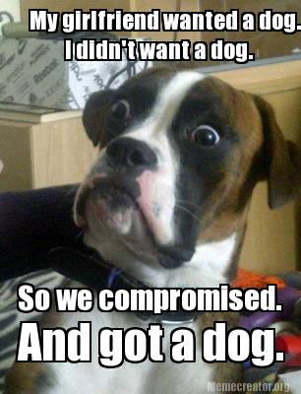
COMPROMISING
In order to reach a compromise, both sides must make concessions; they must both give up a need or a goal. In terms of assertiveness and cooperation, this style is intermediate.
In that this style a solution to the issue that benefits both parties needs to be achieved.
Compromise does solve the issue, but unlike collaboration, it doesn't look for the source of the disagreement.
Compromise is utilised when concerns are significant but not worth taking a forceful stance on, when a quick repair is desired, or when competing or collaborating fails.

Slide 21

ACCOMODATING
In the accommodating style, one meets the objectives of the other party while remaining unassertive and cooperative, as opposed to attempting to force one's own point of view.
While being accommodating, a person forgoes their own demands in favour of the other party's satisfaction. Relationally speaking, this can be advantageous, but it can also result in burnout for the person making the sacrifices.
When the accommodating party knows they are in the wrong, or needs to establish credibility for a later circumstance that might be more crucial to them, or would just like to preserve the peace, accommodation may be suitable.
Accommodators work to maintain interpersonal connections. Being accommodating frequently results in a power imbalance in a relationship, when the accommodating person has less influence and their wants are not addressed.
Making accommodations can be helpful for resolving pointless and insignificant disputes.

Slide 22

AVOIDING
By delaying or avoiding confrontation, the avoidance mode merely avoids it. This approach is frequently perceived as having little concern for the current situation and your connection with the other person.
This style is unassertive and uncooperative. Avoiding something involves moving out of the way, waiting, or just avoiding it altogether.
In moderation, this approach can be helpful, but over time, ignoring disagreements may result in tension building and toxic relationships.
When emotions are running high and one or both sides need some time to collect themselves before handling the current problem, this mode can also be helpful.
This approach is frequently taken when a problem is deemed insignificant, has a reasonable chance of self-resolution, or is overshadowed by a more urgent issue.

Slide 23
CULTURAL DIFFERENCES IN
CONFLICT MANAGEMENT
A group's common values, customs, and beliefs, such as those of a nation or organisation, are referred to as its culture (Hofstede, 1994; Lewicki, Litterer, Minton & Saunders, 1994).
People have a framework for interpreting the intentions and actions of others when they are able to recognise and comprehend the variations in cultural patterns (Hofstede, 1994). This is especially important when people are at conflict and need to work together to achieve shared objectives.
People from various cultures adopt noticeably different conflict resolution tactics, according to research on cross-cultural variances in conflict resolution strategies (Fisher 1980; Tse, Francis & Walls, 1994; Tung, 1984).

Slide 24
COLLECTIVIVIST CULTURES
AND CONFLICT MANAGEMENT
Collectivism describes societies in which people are integrated into strong, cohesive and loyal ingroups (Hofstede, 1994). Collectivist cultures and societies value group goals and outcomes over those of the individual and define themselves in terms of their group membership.
They are therefore willing to sacrifice for their ingroup. According to collectivists, upholding social ties is highly valued (Ting-Toomey, 1988), and harmony frequently takes precedence over achieving goals and fulfilling individual preferences.
Consequently, collectivists strive to minimise disruption and allow group goals to dominate individual goals (Weldon & Jehn, 1995). Importantly, collectivists show more concern about attaining the other party’s goals than about attaining their own goals (Lewicki et al., 1994).

Slide 25
COLLECTIVIVIST CULTURES
AND CONFLICT MANAGEMENT
Unsurprisingly, collectivism and collaboration have a relationship. But despite this desire for cooperation, there is no collaboration.
Conversely, those who come from collectivist societies are more prone to resolve problems by ignoring them or making accommodations. According to various writers, collectivists choose tolerance and avoidance(Ting-Toomey, 1988; Trubisky, Ting-Toomey & Lin, 1991).
Characteristics of Collectivism:
Everyone is urged to participate actively in society and to act in ways that are more beneficial to society as a whole than to themselves.
Families, communities, and the collective all have rights that outweigh an individual's.
Rules foster harmony, camaraderie, and altruism.
Everyone supports one another, and working together and cooperating is the norm.

Slide 26
EXAMPLES OF COLLECTIVIST COUNTRIES
Morocco
Korea
Romania
Russia
Saudi Arabia
Turkey
Nigeria
Zambia
Kenya
Uganda
Somalia
Philippines
Poland
Egypt
India
Pakistan
Bangladesh
Indonesia
Iraq
Afghanistan
Ghana
Belarus
Brazil
Ethiopia
Bulgaria
Georgia
Kazakhstan

Slide 27
INDIVIDUALIST CULTURES
AND CONFLICT MANAGEMENT
INDIVIDUALIST CULTURES
AND CONFLICT MANAGEMENT
Individualism describes societies in which the ties between individuals are loose (Elsayed-Ekhouly & Buda, 1996). Individualist cultures value individual needs and interests over those of the group. They seek to differentiate themselves from others and emphasize personal outcomes over relationships
Individualistic characteristics
"I" identity.
Encourages personal ambition, initiative, and success.
The most significant rights are those of the individual. Rules aim to maintain individuality and self-importance.
In contrast to collectivism, individualism is prised, and there is far less of a desire to support other people or groups.
Being dependent on others or relying on them is generally viewed as dishonourable.
Individuals are urged to take initiative and rely on themselves, and they work for their own accomplishments.

Slide 28
INDIVIDUALIST CULTURES
AND CONFLICT MANAGEMENT
Individualists are likely to value their own perspective (Lewicki et al., 1994), to place personal goals ahead of group goals (Carnevale et al., 1996), to display the fixed bias and to make concessions (compromising) only when necessary to reach an agreement.
These factors are all characteristic of a competing negotiation style and, consistent with this, Rahim (1992) found that individualists were more likely to adopt a competing or dominating style in conflicts.
Research shows that at least some individualists tend to be authoritative, autocratic and in a hurry to make a deal (Goldenberg, 1988). They are more self- assertive and self-reliant and show a preference for getting down to the task and the ‘bottom line’ as soon as possible (Goldman, 1991; Tse, Lee, Vertinsky & Wehrung, 1988).

Slide 29
EXAMPLES OF INDIVIDUALIST COUNTRIES
United States
Australia
United Kingdom
Canada
Netherlands
Hungary (post-communist generation)
New Zealand
Italy
France
Belgium
Ireland
Switzerland
Germany
South Africa
Luxembourg
Czech Republic (post-communist generation)
Austria
Israel
Slovakia (post-communist generation)
Poland (post-communist generation)
Lithuania
Latvia
Estonia

Slide 30
DIRECT COMMUNICATION
When a speaker verbally expresses their genuine intentions, this is known as direct communication.
The messages of direct communicators frequently lack underlying significance. They admire candour, honesty, and candid responses.
The expression of criticism is more open and it is taken less personally in this communication style, which is regarded as being more "task-oriented."
Direct people are accustomed to openly disagreeing with others and are not frightened of controversy. Honesty is the greatest policy in their eyes.
The individualist societies are consistent with direct communication. People in these cultures are concerned with taking action and solving problems.

Slide 31
INDIRECT COMMUNICATION
True intentions may only be communicated indirectly when they are conveyed nonverbally or through context.
To avoid responding "no," they will come up with more complicated methods to respond.
Giving an honest answer is less essential to them than "saving face" or avoiding damaging another person's self-esteem.
Indirect speakers will convey their displeasure or disquiet by non-verbal cues, ambiguity, or even by complaining to a third person because direct conflict must be avoided at all costs.
Direct communication is a defining feature of collectivist cultures.
Indirect speakers often avoid making a direct comment that can incite disagreement or tension.

Slide 32
BIBLIOGRAPHY
https://www.familymediationcouncil.org.uk/us/code-practice/general-principles/
https://peacemaker.un.org/sites/peacemaker.un.org/files/GuidanceEffectiveMediation_UNDPA2012%28english%29_0.pdf
https://blog.hubspot.com/service/conflict-management-styles
https://minutemediation.com/5-styles-of-conflict-management/
https://en.wikipedia.org/wiki/Conflict_management_style
https://en.wikipedia.org/wiki/Thomas–Kilmann_Conflict_Mode_Instrument
https://psychology.fandom.com/wiki/Collectivist_and_individualist_cultures
https://multiculturalyou.com/2020/06/22/direct-and-indirect-communication-styles/
Hofstede, G. 1994. Cultures and organizations: Software of the mind, London: McGraw Hill. Hofstede, G. & Bond, M.H. 1988. Confucius and economic growth: new trends in culture’s consequences. Organizational Dynamics, 16 (4): 4-21.
Ting-Toomey, S. 1988. Intercultural conflict styles: A face-negotiation theory. In Y. Kim & W. Gudykunst (Eds.), Theories in intercultural communication: 213-235, Newbury Park, CA: Sage.
Elsayed-Ekhouly, S.M. & Buda, R. 1996. Organizational conflict: a comparative analysis of conflict styles across cultures. International Journal of Conflict Management, 7 (1): 71-81.
Carnevale, P.J., Probst, T.M., Hsueh, E. & Triandis, H.C. 1996. Cooperation and culture in intergroup and single-group social dilemmas, (Unpublished manuscript) Urbana-Champaign, IL: University of Illinois at Urbana-Champaign.
Rahim, M.A. 1992. Managing conflict in organizations, (second edition), Westport CT: Praeger.
Goldenberg, S. 1988. Hands across the ocean: Managing joint ventures with a spotlight on China and Japan, Cambridge, MA: Harvard University Press.
Goldman, A. 1991. Negotiating protocol in Japan: A crosscultural perspective. International Journal of Management, 8: 808-813.
Womack, Deanna F. (1988). "Assessing the Thomas-Kilmann Conflict Mode Survey". Management Communication Quarterly. 1 (3): 321–349.

