Slide 1
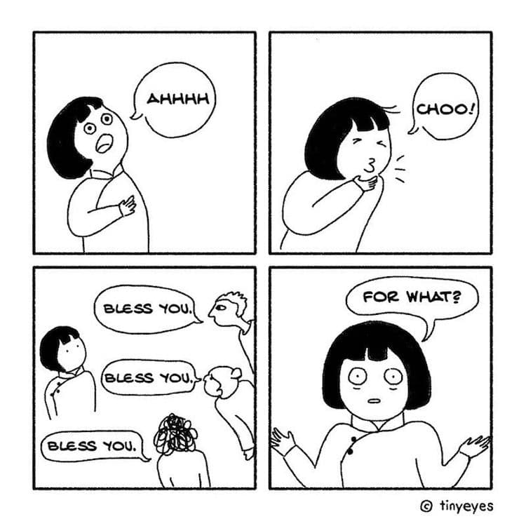


MULTICULTURAL COMMUNICATION

Slide 2
KEY WORDS
Multicultural - A society is said to be multicultural if it comprises a variety of cultural or ethnic groupings. Although people coexist, not all cultural groups necessarily engage in relationships with one another. For instance, residents of a multicultural area could visit restaurants and ethnic grocery stores without really mingling with their international neighbours.
Cross- cultural – is the comparison of various cultures. Cross-cultural dialogue can result in individual change but not communal transformations since disparities are recognised and acknowledged. In multi-cultural communities, one culture is frequently seen as "the norm" and all others are contrasted with or compared to it.
Intercultural - Communities that have a strong appreciation and regard for all cultures are said to be intercultural. The creation of strong connections and the exchange of ideas and cultural norms are the main goals of intercultural communication. No one remains unaltered in a multicultural society since everyone shares knowledge and develops together.

Slide 3
KEY WORDS
Surface culture - the apparent and instantly recognisable components of a culture are referred to as surface culture. It includes things like ethnically distinctive foods, dialects, works of art, books, festivals, and clothing.
Deep culture - relates to conceptions of self and society, concepts of etiquette, body language, communication styles and customs, and other more subtle aspects of culture. By visiting or interacting with a foreign culture, people frequently get first-hand experiences of deep culture.
In order to to be successful and respectful in multicultural communication it is crucial to be aware of a person's surface and deep cultural specifics.

Slide 4
MULTICULTURAL COMMUNICATION
Multicultural communication is the process through which individuals from various cultures exchange information. Every culture has its own set of values, beliefs, and conventions, which might affect how information is understood. It is vital to keep this in mind.
It is crucial to be aware of these distinctions and to modify your communication style when speaking with someone from a different culture. For instance, whereas some cultures value formal language highly, others choose a more straightforward style. You may make sure that your message is understood how you wish it to be by taking the time to learn about the communication practises of other cultures.
Multicultural communication is a process of understanding and relating to individuals from other cultures, going beyond merely exchanging information. It entails considering the cultural distinctions that exist between individuals and utilising that knowledge to produce meaningful relationships.

Slide 5
MULTICULTURAL COMMUNICATION
The goal of multicultural communication is to unite the largely unconnected disciplines of cultural anthropology and established communication.
It aids understanding of how people from different cultures interact with one another.
It aims to establish certain rules that will help individuals from various cultures communicate with one another more effectively.

Slide 6
MULTICULTURAL COMMUNICATION IN ORGANISATIONS
How to properly connect with people from diverse cultural backgrounds inside an organisation is one of the largest and most pressing issues confronting organisations across the world today.
Throughout every nation, race, and culture, there are subtle cultural differences. They become much more obvious when a single organisation operates in numerous geographic locations or hires employees of varied racial and cultural backgrounds.
When cross-cultural collaboration is unsuccessful, it can cause cultural and contextual misunderstandings that can be detrimental to an organisation.
The necessity for organisations to have be multiculturally competent is essential for successful communications within and outside of the organisation.

Slide 7
MEYER’S 8 SCALES OF
MULTICULTURAL COMMUNICATION
Meyer's 8 scales can help you increase the efficacy of your communication with clients when working as a multicultural mediator.
The scales are not graded; rather, the goal is to draw attention to the variations and to raise awareness among global enterprises of the numerous cultural settings that influence people's perspectives.
Understanding these circumstances and adjusting our own communication styles while interacting with others are the keys to effective multicultural communication.

Slide 8



MEYER’S 8 SCALES OF
MULTICULTURAL COMMUNICATION
Communicating - Low-context or high-context communication styles are used in communication. Simple, straightforward, and direct are the characteristics of low-context communication. Switzerland, Germany, the United States, and Ireland favour a low-context communication approach. A high-context communication style relies on internalised principles, is implicit, and is indirect. High-context communication is common in nations like Japan, China, Thailand, and the UAE.
Evaluating - Either direct or indirect feedback is required in this situation. Russians, Dutch, and Israelis tend to be the most direct when giving negative feedback. As a consequence, you get direct, candid, and honest feedback. On the other side, Japanese people tend to be among the most subtly indirect and will approach giving negative feedback subtly and covertly.
Persuading - This might be seen as a communication strategy that prioritises principles above applications. Before providing a fact or opinion, certain culture, like Italians and the French, employ holistic arguments that focus on concepts. Those in other cultures, primarily those in the Commonwealth, prefer to debate theories after logical arguments have been made.

Slide 9



MEYER’S 8 SCALES OF
MULTICULTURAL COMMUNICATION
Leading - Each culture has its own unique view of what it means to be a leader. The most typical leadership philosophies are egalitarian and hierarchical. A flat organisational structure with equal status for managers and employees is preferred by egalitarian leadership. Nordic egalitarian nations include those like Sweden and Denmark. The hierarchical leadership style, in which the supervisor is seen as superior to all employees, is favoured in nations like Saudi Arabia and Korea.
Deciding - Either consensus-based or top-down decision-making is prevalent in many cultures. Countries like Japan and the Netherlands use consensus-based choices that account for a variety of viewpoints to determine how the general population feels. Top-down decision-making is preferred in nations like Nigeria and China, where CEOs and corporate owners speak for the whole organisation.
Trusting - Task-based and relationship-based trust styles are the two types that different cultures adopt. In task-based cultures like those in the USA and Australia, trust is developed via work-related activities. In cultures that value relationships, such as those in India and China, trust is built through close relationships and experience.

Slide 10


MEYER’S 8 SCALES OF
MULTICULTURAL COMMUNICATION
Scheduling - Perception of time and schedule differ from culture to culture and can range from linear to flexible on the scheduling scale. Linear styles focus on one task before they move to the next one and prefer to adhere to deadlines. Moreover, such cultures find it impolite to shift attention from one task to the other without finishing the first task. Cultures such as Kenya and Saudi Arabia are flexible where timelines are concerned and believe in multi-tasking. Different topics can be addressed at the same time, and adaptability is a value that holds more weight.
Disagreeing - Disagreements are natural and inevitable in a social construct. However, different cultures perceive disagreements in different ways. Based on cultures, disagreements can be confrontational or they endeavour to avoid confrontations. Cultures that are confrontational by nature, such as France and Israel, are able to separate the person from their proposed idea that they do agree with. On the other hand, cultures such as Japan and Indonesia have cultures that believe that open confrontation can disrupt the harmonious setting of a group. They also believe that the idea a person puts forth is not separated from the person, therefore disagreeing with the idea is considered equal to disagreeing with the person.

Slide 11
THE IMPORTANCE OF MULTICULTURAL COMMUNICATION
Multicultural communication is vital for many reasons. In order to build harmonious relationships and prevent conflict, competent multicultural communication is a crucial ability for anybody working with people of different cultures especially in multicultural mediation.
Information must be transferred across cultures and nations correctly and appropriately. Excellent multicultural communication skills are especially useful for mediators who interact with clients and from across the world while working either in their home country or as expats abroad.
To prevent misunderstandings and even offence, multicultural communication is essential for anybody dealing with individuals from various cultures. It's safe to assume that in today's globalised world, multicultural communication is the cornerstone of successful relationships with others.

Slide 12
MULTICULTURAL COMPETENCE
The American Sociological Association defines culture as the collective identities and memories formed by members of all social groups that give their social settings meaning.
It also includes languages, conventions, beliefs, regulations, arts, and knowledge. All the components that make up your personality make up culture. In essence, it's how we think and behave.
Competence is the capacity to do a task successfully. To prove our competence in anything, we must carry out a certain task or activity to the best of our ability.

Slide 13
MULTICULTURAL COMPETENCE
Multicultural Competence - The capacity to comprehend, value, and communicate with those who identify with cultures and/or belief systems other than your own.
Multicultural competency results in improved and efficient interpersonal communication, which can build relationships. In the end, connections play a significant role in what makes us human.
This definition makes it seem as though effective communication abilities would be sufficient. Yet being culturally competent calls for more than just effective communication.

Slide 14
CULTURE WHEEL
The culture wheel is one tool for understanding and examining culture. As we all know, a variety of elements contribute to who we are and influence our everyday actions and behaviour. The cultural wheel may be a useful tool for understanding how other people affect ourselves.
The various facets of cultural variety that go into creating who we are are represented on the culture wheel. These are a few illustrations of how certain demographics may shape your culture and perspective. This can ultimately aid in defining our cultural identities.
Also, it can support who we are. We need to respect and comprehend people from all cultures if we want to be culturally competent.

Slide 15
CULTURE WHEEL
Gender
Personality
Religion
Ethnicity
Race
Sexual Orientation
Community

Slide 16
INTERPERSONAL SKILLS IN MULTICULTURAL COMMUNICATION
We use our interpersonal skills in a variety of ways in interpersonal contexts (think: regular social encounters). We use our interpersonal skills, for instance, each time we visit a shop or speak to a stranger.
We use our interpersonal abilities whether interacting with friends or talking to co-workers. In order to be culturally competent, we must be conscious of our surroundings. Our ability to interact and form relationships with people from other cultures depends on our interpersonal abilities.
You probably utilise your interpersonal skills frequently in your everyday dealings. Use a few of these suggestions. Most people simply begin their exploration of foreign cultures by posing open-ended questions.
Be open-minded and tolerant of diversity; embrace diversity of thought.
Show humility without bias and an aptitude for learning.
Be understanding of others by acknowledging cultural diversity and individual cultural identities.
Demonstrate an adventurous attitude by being curious and looking for chances in every circumstance.
By showcasing a productive encounter with the identified, you can practise positive change or action.

Slide 17
BARRIERS IN
MULTICULTURAL COMMUNICATION
People's habit to interpret their ideas and experiences through the prism of their own culture is one of the largest obstacles to multicultural communication.
As various cultures frequently have different ways of experiencing the world, this can result in misconceptions and miscommunication.
For instance, while making direct eye contact with someone you are speaking to is frowned upon in certain cultures, it is seen as a show of respect in others.
So, it's critical to be aware of how cultural filters may affect communication. We can make sure that our message is clearly and precisely understood by taking the time to comprehend the cultural context of a communication.

Slide 18
BARRIERS IN
MULTICULTURAL COMMUNICATION
Our preconceived ideas about which culture is "correct" or "superior" can occasionally act as a barrier to effective multicultural dialogue.
If we wish to effectively interact with individuals from various cultures, we must be open-minded and eager to learn.
It is crucial to build multicultural communication skills in order to get beyond these obstacles.
We need create bridges rather than walls by becoming empathetic and learning about various cultures. Only and only then can we genuinely expect to comprehend one another.

Slide 19
BARRIERS IN
MULTICULTURAL COMMUNICATION
The language barrier among people, including accents and fluency, is a more visible difficulty when we deal with clients in multicultural mediation who come from different cultures and speak different languages and dialects.
Although English is one of the most common spoken languages across the world, many people will struggle to understand each other if they come from different parts of the world or even the same country!
Interpersonal tension and dissatisfaction might result from this between your clients when they don’t understand each other and in turn create conflicts which you later mediate.

Slide 20
BARRIERS IN
MULTICULTURAL COMMUNICATION
IN ORGANISATIONS
In Western societies, communication is straightforward and the meaning often seems clear. Different cultures frequently convey their messages in a more subtle manner.
Communication between a Westerner and a non-Westerner might therefore lead to misunderstanding at work, daily life or in families. Both in-person encounters and virtual communication are capable of this.
It goes without saying that a key determinant of an organisation's ability to function cohesively is how employees from different cultures interact with one another.
For instance, in Western culture, the query would be, "Which choice is more efficient, option A or option B?". But in other cultures from the East, the employees will not be engaged in the process of choosing options and debating the options available.

Slide 21
MANAGING A MULTICULTURAL CLIENT
It is crucial to have cultural sensitivity and diversity right from the beginning because these concepts are difficult to instil later. To ensure that potential clients feel safe and secure in the multicultural mediation process it is important to evaluate cultural sensivity across the whole mediation process.
You should also incorporate cross-cultural training and cultural sensitivity. This will help to establish clear cultural context from the outset, establish multicultural values, and provide the clients with the abilities necessary to function effectively in a multicultural context.
Regularly reinforcing these beliefs is also crucial. Establish a distinct culture that values diversity and share it frequently.

Slide 22
BODY LANGUAGE IN
MULTICULTURAL COMMUNICATION
It is important that in the work of a multicultural mediator you are able to read the body language of your clients and those around you. However what might be perceived in one culture will not be perceived in the same way in another.
In certain cultures, eye contact is the global language, as is body language used to express emotions, gestures used to say hello and goodbye, and touches used to express friendship and love. No matter who you are or what you need to say, everyone can understand it.
The issue occurs because while certain gestures or acts are the same across cultures, their meanings vary greatly. Many times, a gesture that seems innocent to us may be offensive to a person from another culture. For instance, the "OK" sign is used as a "superb" gesture in India, while using it in Turkey is tantamount to inciting a brawl since it is regarded as disrespectful.

Slide 23
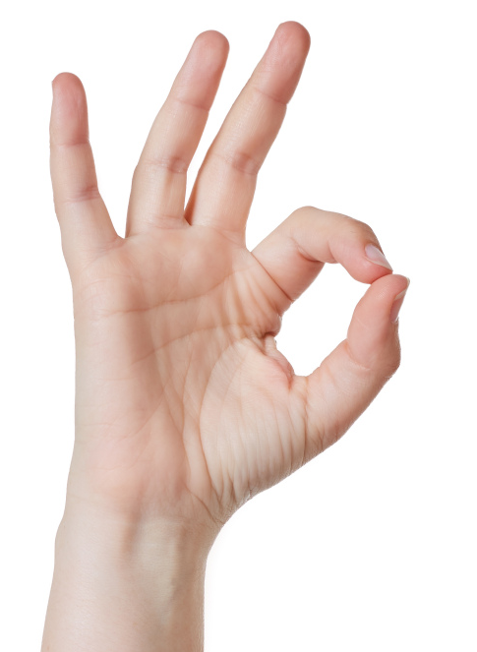
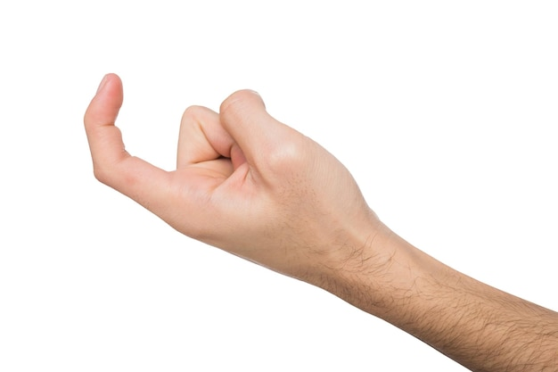
HAND GESTURES
We highlight points and accentuate what we are saying through the use of gestures.
Many cultures have highly varied interpretations of hand gestures; for example, in Greece, Spain, or Brazil, the 'OK' sign denotes calling someone an asshole. In Turkey it is intended as an insult towards LGBTQ+ people.
People frequently call someone to approach them in the United States and several regions of Europe by curling the index finger with the palm facing up.
Yet, it is considered disrespectful in China, East Asia, Malaysia, Singapore, the Philippines, and many other regions of the world. Using this gesture with others is also viewed as being exceedingly disrespectful. In several Asian nations, it is solely used to summon dogs; employing it in the Philippines might result in getting arrested.

Slide 24

EYE CONTACT
Eye contact is regarded as a mark of confidence and focus in the majority of western nations. When someone does not look at us, they are not listening and we often believe that they are uninterested and seeking for someone else to chat to.
Same-gender eye contact is more frequent and strong in many Middle Eastern nations than it is in the west. Beyond a fleeting glimpse, eye contact between different genders is frowned upon in several of these nations.
Nonetheless, this constant eye contact would be regarded as hostile and confrontational in many Asian, African, and South American nations. A show of respect for superiors and elders in these cultures is to avoid making eye contact with them. These cultures have a strong sense of hierarchy.

Slide 25

TOUCH
The Far East and Northern Europe are categorised as non-contact civilizations. Beyond a handshake, we seldom make physical touch with others we don't know well. Even accidently touching someone's sleeve on the street demands an apology.
In contrast, physical touch plays a significant role in socialising in the high-contact cultures of the Middle East, South America, and Southern Europe.
In much of the Arab world, males greet one other by holding hands and kissing, but they would never do the same with a woman.
It is forbidden to touch anyone's head in Thailand and Laos, including children and statues as the head is seen as a sacred pat of the body.

Slide 26

SITTING POSITIONS
When you are dining or attending meetings, pay attention to your posture. In Japan, sitting with your legs crossed is considered disrespectful, especially when you are with someone more senior or respected than you.
In some regions of the Middle East and India, showing the bottoms of your shoes or feet might insult people. Because of this, throwing shoes at someone is considered an insult and a means of protest in many cultures.

Slide 27
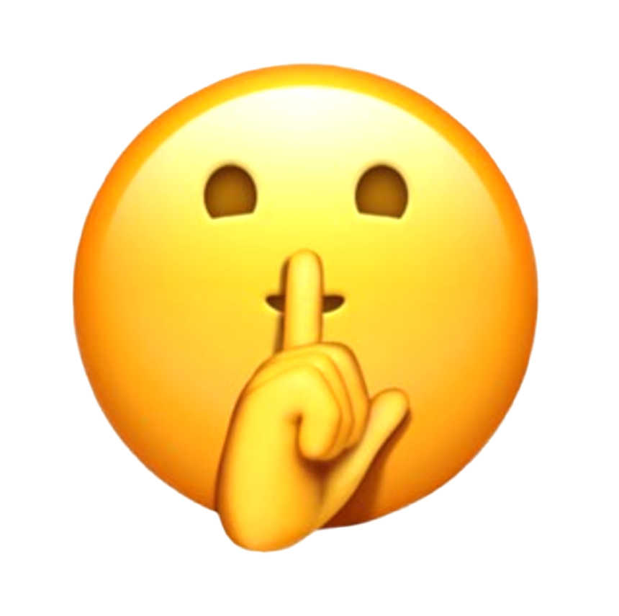
SILENCE
Although though silence might seem like a communication gap, it can have deep cultural significance.
Silence is typically seen negatively in Western societies, particularly in North America and Ireland. Silence is unwelcome in the encounters with co-workers, students, or friends. It is frequently seen as an indicator of inattention or indifference.
Yet, silence is not seen as a bad thing in some cultures. Silence can be used to convey acceptance and receptivity in China.
In many indigenous cultures, a question won't be addressed until after some quiet reflection. In Japan, women’s silence is regarded as a sign of femininity.

Slide 28
HOW TO BE EFFECTIVE IN MULTICULTURAL COMMUNICATION
Display a desire to learn and be inquisitive
Being culturally competent is having an interest in other people's cultures. Learning is more than just reading books and doing some web research. Having new experiences is a key component of learning. You must allow yourself to develop intercultural awareness and competency if you want to learn. To enable new learning to connect with you, your body, and your mind, you must first allow yourself to unlearn what you previously learned.
Be positive when it comes to other cultures
It matters how you receive and treat people. This reflects your openness to interacting with people from culturally distinct backgrounds. It involves recognising others' innate creativity, resourcefulness, and wholeness. Each person has a unique manner of expressing oneself or others, regardless of background. It's crucial that you communicate with others in a friendly and open manner without passing judgement on them.

Slide 29
HOW TO BE EFFECTIVE IN MULTICULTURAL COMMUNICATION
Employ a multicultural communication approach that works - Multicultural management can be challenging. It can be helpful to create a consolidated, organisation wide plan for localisation, translation, and multicultural communications.
Clear and thoughtful communication - Speaking or writing effectively while keeping in mind your ethnic audience is another important aspect of multilingual communication. Speaking slowly will make it easier for EAL speakers to comprehend you if you're talking.
Avoiding idioms and regional figures of speech is a good idea in both writing and speaking. To an English speaker, "it’s raining cats and dogs" makes sense. Yet, they would say "it's raining chair legs" in Greek. Be careful with the jokes; they frequently lose sense when translated.
Remember your manners - Many cultures have distinct etiquette conventions. Both oral and written communication are subject to these regulations. If you cross them, you run the danger of alienating your audience. Be aware of what different things mean across cultures before you engage with them.

Slide 30

TIPS FOR EFFECTIVE
MULTICULTURAL COMMUNICATION IN MEDIATION
Issues with communication might become more challenging in today’s society. When it comes to face-to-face conversations, each culture has its own set of tacit assumptions and proclivities, making it sometimes challenging to communicate successfully. Even without a language barrier, communicating between cultures may be difficult. Here are some tips that will make multicultural communication in mediation easier for you.
Maintain etiquette - Many nations have established rules regarding how to communicate. Undertake multicultural training before your meeting or conduct some research on the target culture. Be polite and know what the social ques of different cultures mean, especially those that are your client. This will help you to avoid further conflict and show respect to a give culture or group.
Steer clear of slang - Even the most educated non-native English speaker won't fully comprehend all of the slang, idioms, and sayings used in English. Although they might understand each word you spoke individually, they could not understand the context or meaning. So, you can wind up perplexing them or, in the worst case scenario, insulting them.

Slide 31


TIPS FOR EFFECTIVE
MULTICULTURAL COMMUNICATION IN MEDIATION
Talk slowly - Although though English is often spoken in multicultural settings, speaking at your typical conversational pace can be problematic to understand for those whose English is not their first language. Changing your tempo, as well as speaking clearly and using good word pronunciation, will be beneficial. Give your client/s time to translate and understand your words as you speak by breaking your sentences into brief, distinct chunks. But, avoid going too slowly to avoid coming across as patronising. Do not be hesitant to urge someone to slow down if you are having trouble understanding them because they are speaking too fast or have an accent which you have trouble understanding.
Keep it basic - There's no need to use complicated terms in a multicultural dialogue, this can cause even more confusion when you communicate with your clients who might not understand what you are saying. Always double check that the client has understood what you are saying and if not explain it to them again to make sure you are both on the same page.

Slide 32



TIPS FOR EFFECTIVE
MULTICULTURAL COMMUNICATION IN MEDIATION
Practice active listening - Active listening is a very effective strategy for improving multicultural communication. Restate or summarise what the other person has said, to ensure that you have understood them correctly, and ask frequent questions. This helps build rapport and ensures that important information doesn’t get missed or misunderstood.
Write things down - If you’re not sure whether the other person has understood you properly, write it down to make sure. This can be particularly helpful when discussing cultural matters that you are not familiar with. This will allow you to go back to points you have missed or misunderstood.
Be careful with humour - Many cultures take business very seriously and believe in behaving professionally and following protocol at all times. Consequently they don’t appreciate the use of humour and jokes in a business context. If you do decide to use humour make sure it will be understood and appreciated in the other culture and not cause offence.
Be supportive - Effective multicultural communication is about all parties feeling comfortable. In any conversation with a non-native English speaker, treat them with respect, do your best to communicate clearly and give them encouragement when they respond. This will help build their confidence and trust in you.

Slide 33
BIBLIOGRAPHY
https://www.unitedlanguagegroup.com/blog/five-keys-to-effective-multicultural-communication
https://wearebrain.com/blog/innovation-and-transformation-strategy/communication-in-a-multicultural-environment/
https://en.wikipedia.org/wiki/Cross-cultural_communication
https://www.chrysos.org.uk/blog/top-ten-tips-for-effective-cross-cultural-communi
https://springinstitute.org/whats-difference-multicultural-intercultural-cross-cultural-communication/
https://www.forbes.com/sites/forbeshumanresourcescouncil/2021/01/21/12-practical-ways-to-ensure-effective-communication-among-multicultural-team-members/
https://www.countrynavigator.com/blog/what-is-the-biggest-barrier-to-cross-cultural-communication/
https://trainingindustry.com/blog/diversity-equity-and-inclusion/4-types-of-communication-challenges-in-multicultural-organizations/
https://online.edhec.edu/en/blog/how-to-manage-multicultural-teams/?utm_source=google&utm_medium=adssearch&utm_campaign=DSA—Uk_notoriété_2022&gclid=CjwKCAiA9NGfBhBvEiwAq5vSyzTy3o-IP7pzWjRiZaqjr-_xxjtW1ClyFiPG_4X6wd_nsSbwIaHaABoC_iEQAvD_BwE
https://www.betterup.com/blog/multicultural-competence

